Slide 1
Review of NYC Data

Slide 2
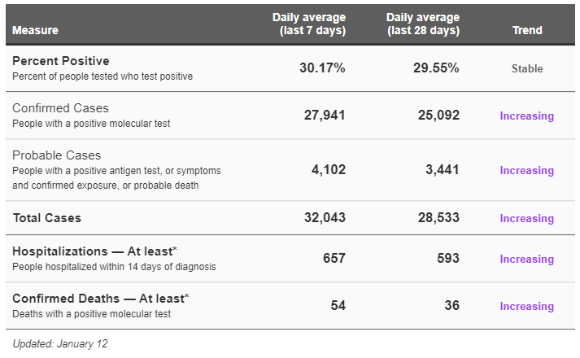
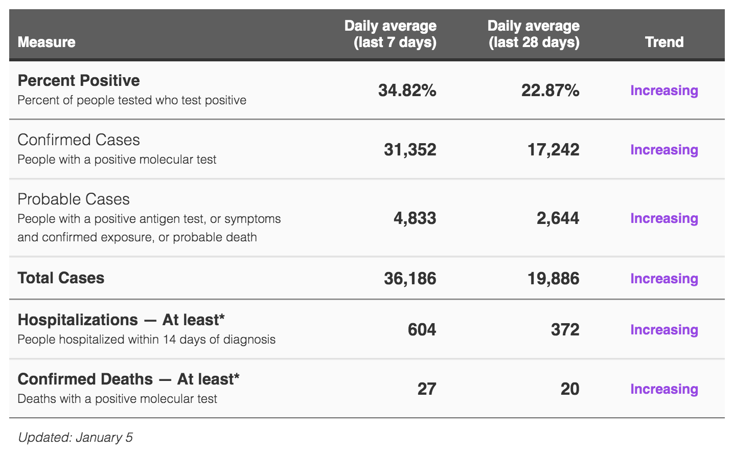

NYC Data
https://www1.nyc.gov/site/doh/covid/covid-19-data.page

Slide 3
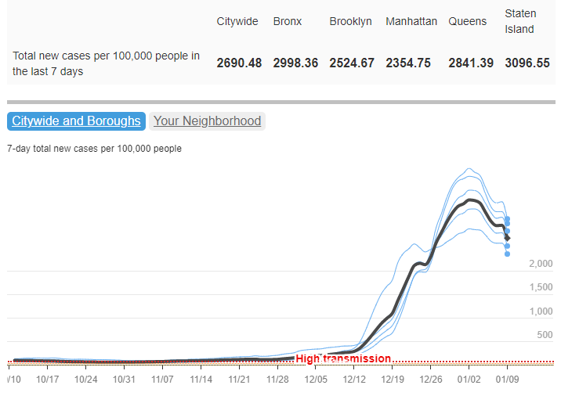
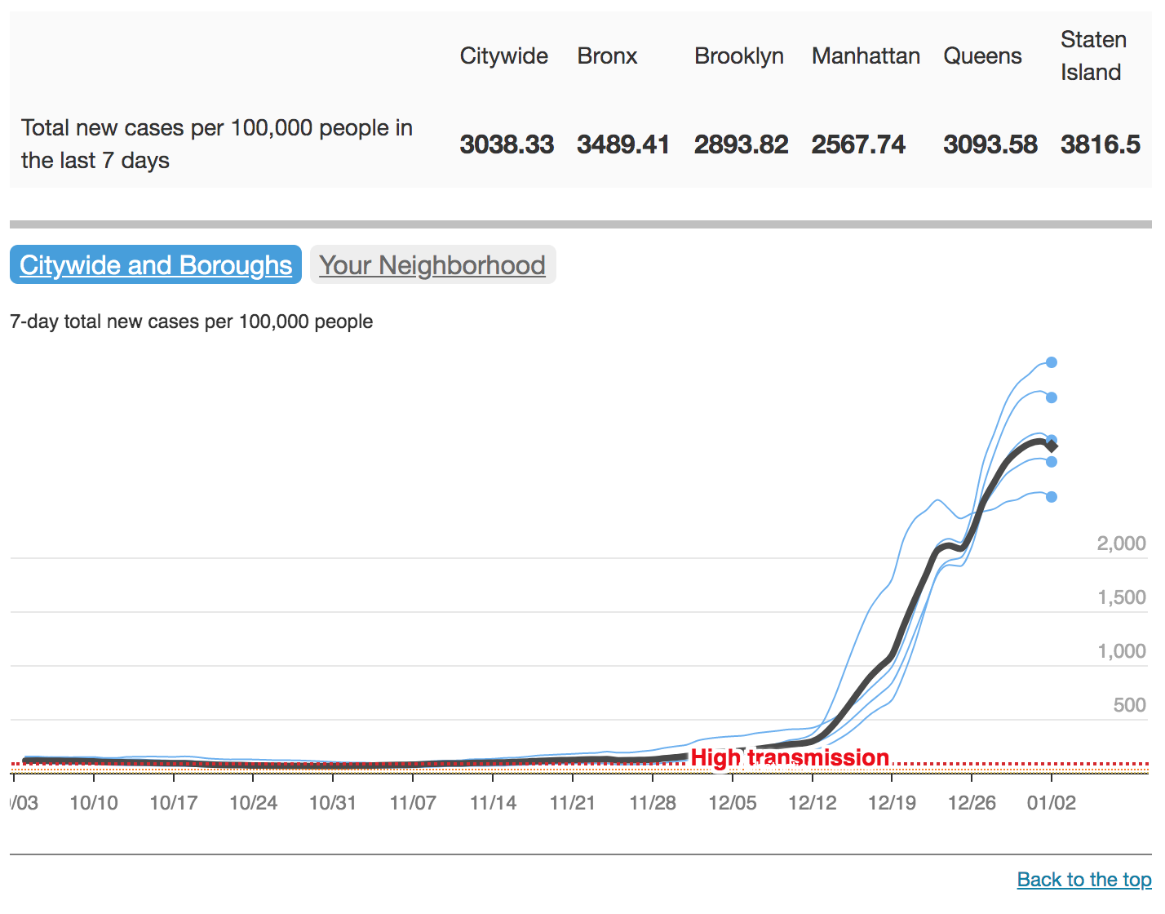
NYC Data
Community transmission is high in all NYC boroughs (highest in Staten Island).
https://www1.nyc.gov/site/doh/covid/covid-19-data.page

Slide 4
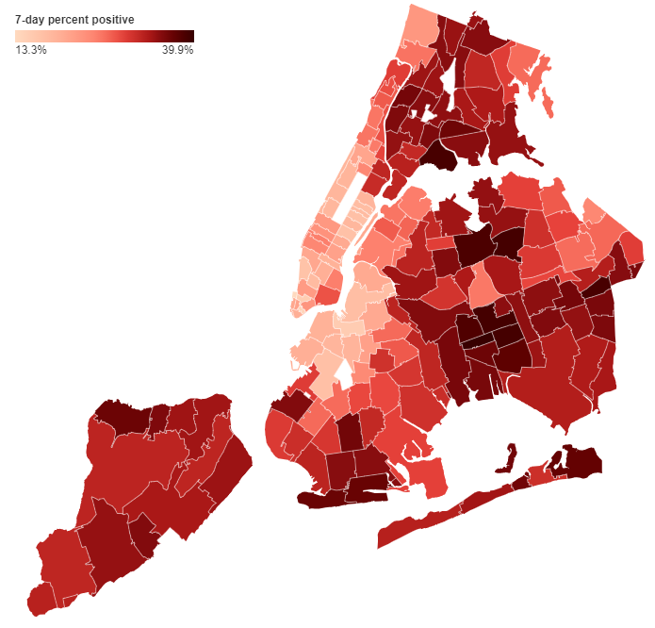
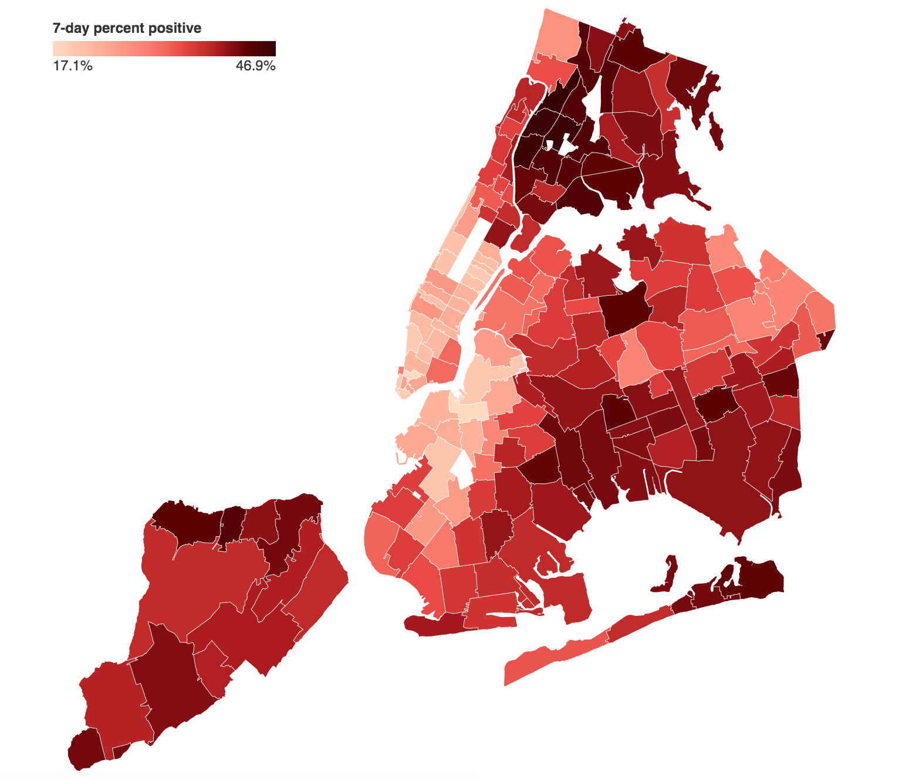
NYC Data
https://www1.nyc.gov/site/doh/covid/covid-19-data.page

Slide 5
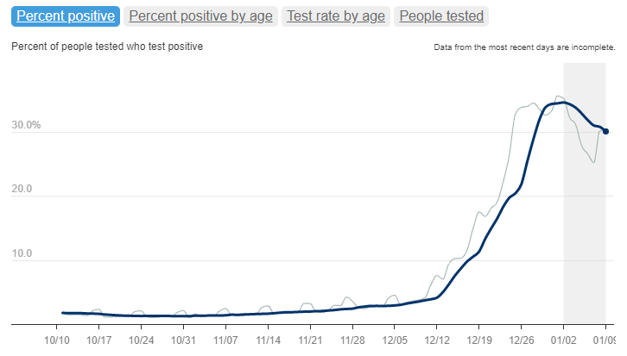
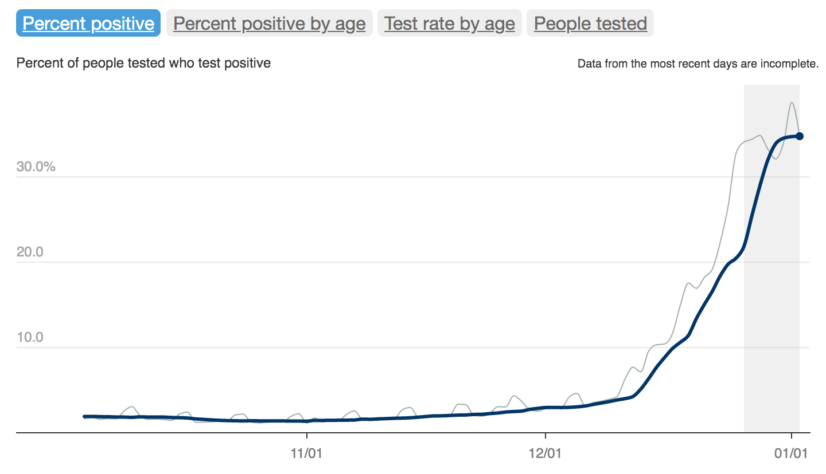
NYC Data
Percent of NYC-ers tested for COVID-19 who are positive climbed to nearly 35%, but is now declining.
https://www1.nyc.gov/site/doh/covid/covid-19-data.page

Slide 6
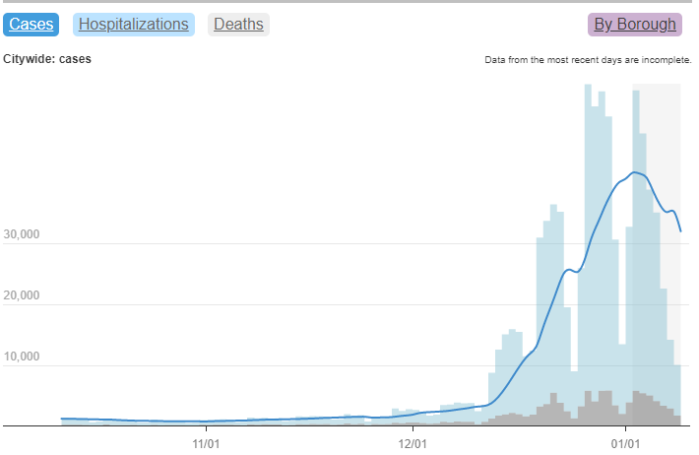
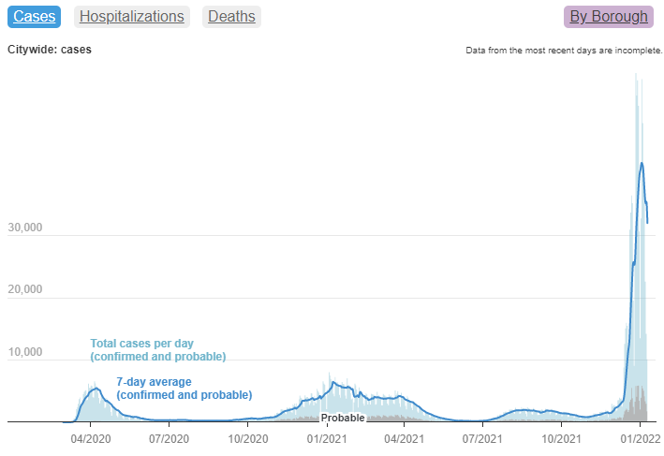
NYC Data
Cases appear to have peaked across NYC and are now slowly declining.
=
https://www1.nyc.gov/site/doh/covid/covid-19-data.page

Slide 7
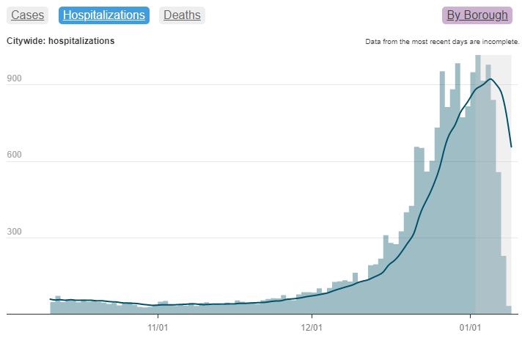
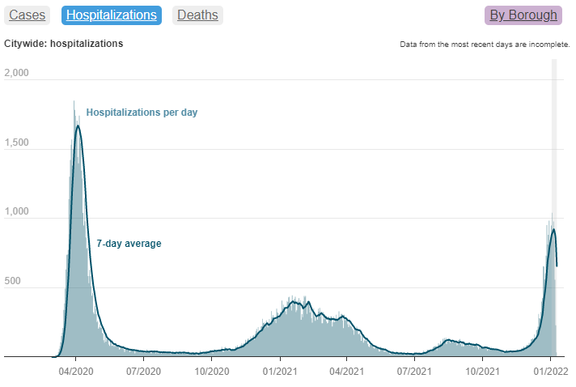
NYC Data
Hospitalizations appear to be plateauing and may have already peaked
=
https://www1.nyc.gov/site/doh/covid/covid-19-data.page

Slide 8
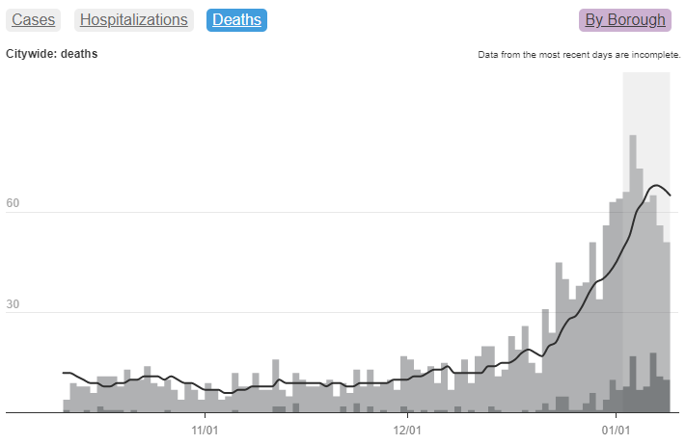
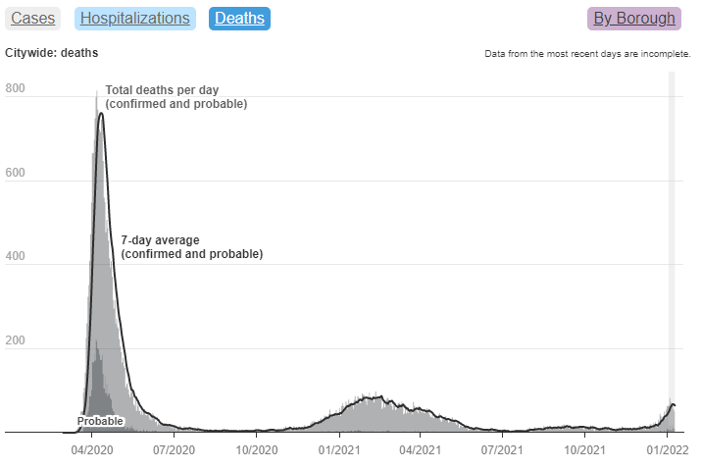
NYC Data
Deaths lag behind hospitalizations and continue to rise.
=
https://www1.nyc.gov/site/doh/covid/covid-19-data.page

Slide 9
Review of NYC Health + Hospitals Data
https://www1.nyc.gov/site/doh/covid/covid-19-data.page

Slide 10
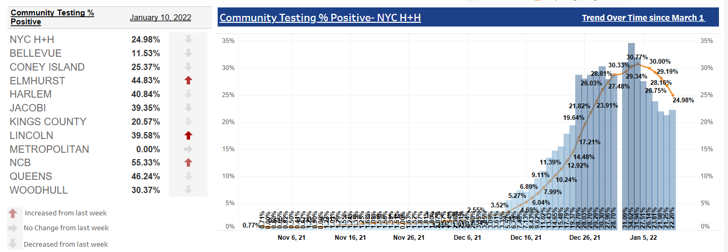
Health + Hospitals Data
Initial decline in COVID-19 positivity among community testing

Slide 11
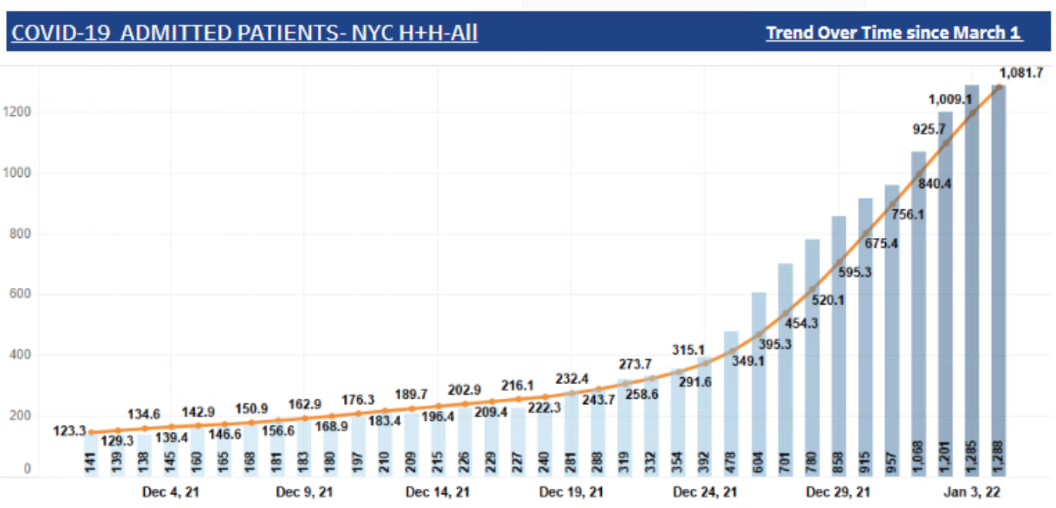
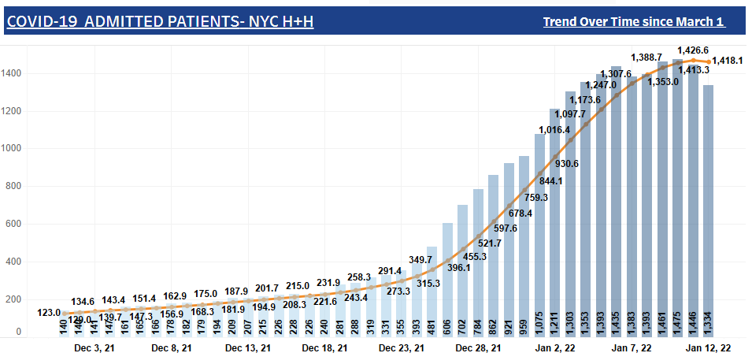
Health + Hospitals Data
Plateauing in COVID-19 hospitalizations
1 in 3 is vaccinated: slow increase from early December
As of last week
As of today

Slide 12
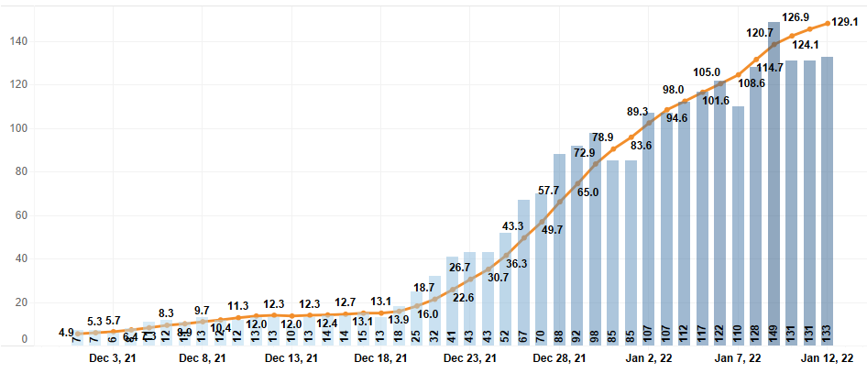
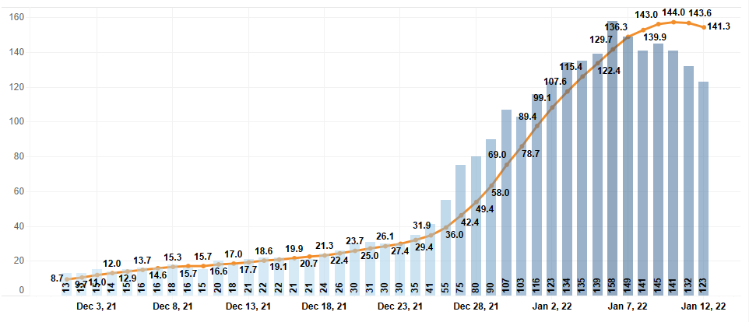
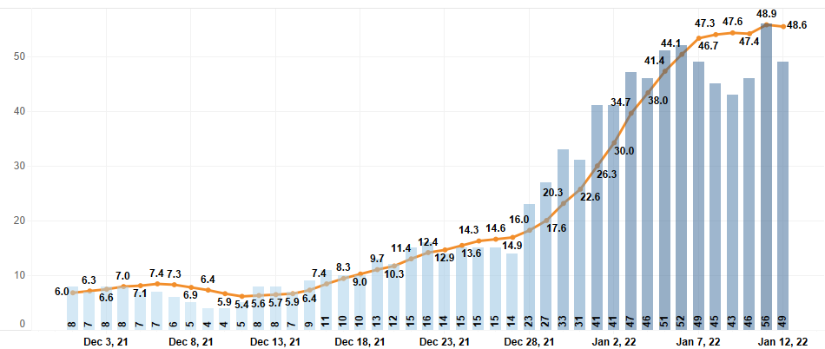
Health + Hospitals Data
Plateauing in COVID-19 hospitalizations
By facility:
Lincoln
Jacobi
NCB

Slide 13
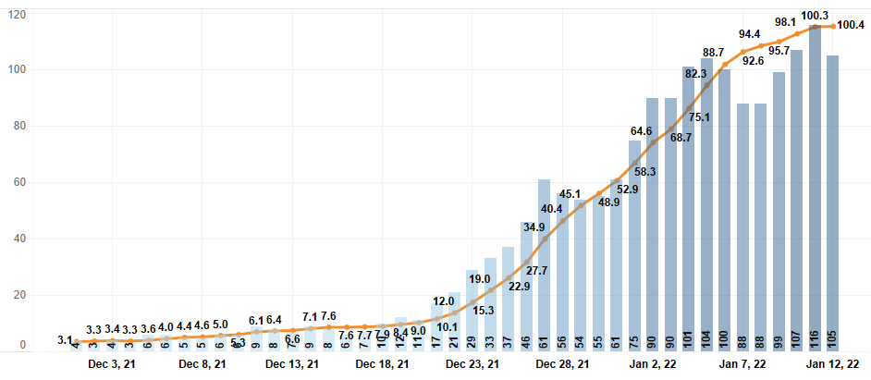
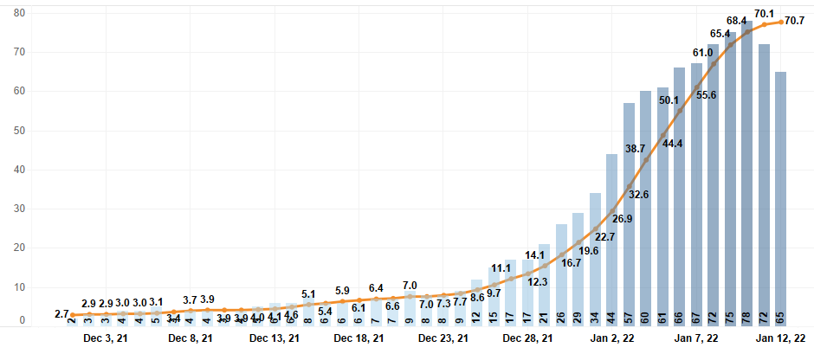
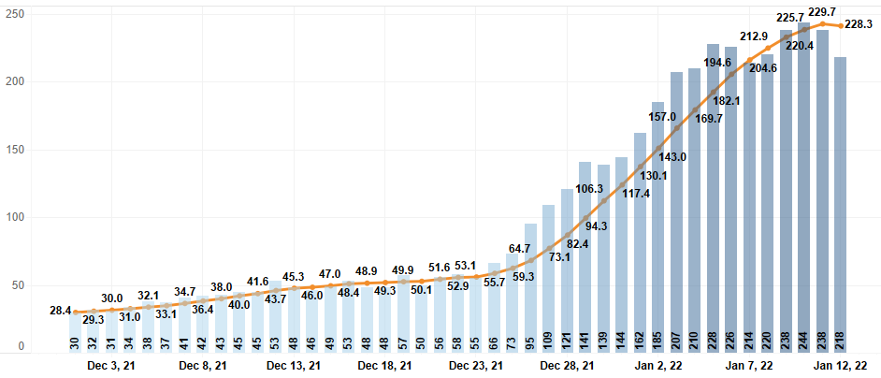
Health + Hospitals Data
Plateauing in COVID-19 hospitalizations
By facility:
Harlem
Metropolitan
Bellevue

Slide 14
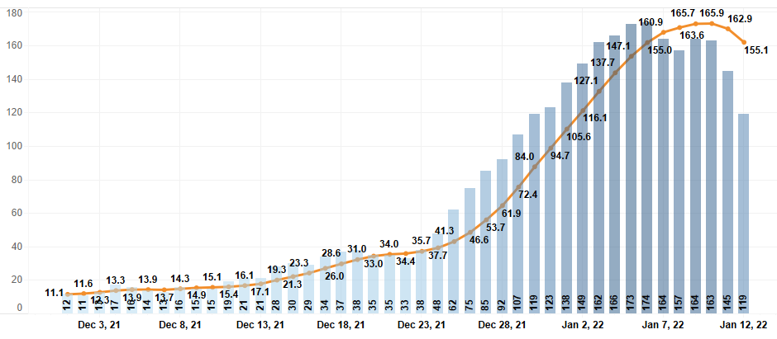
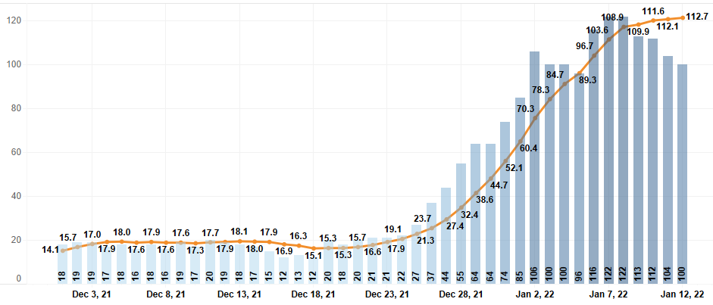
Health + Hospitals Data
Plateauing in COVID-19 hospitalizations
By facility:
Elmhurst
Queens

Slide 15
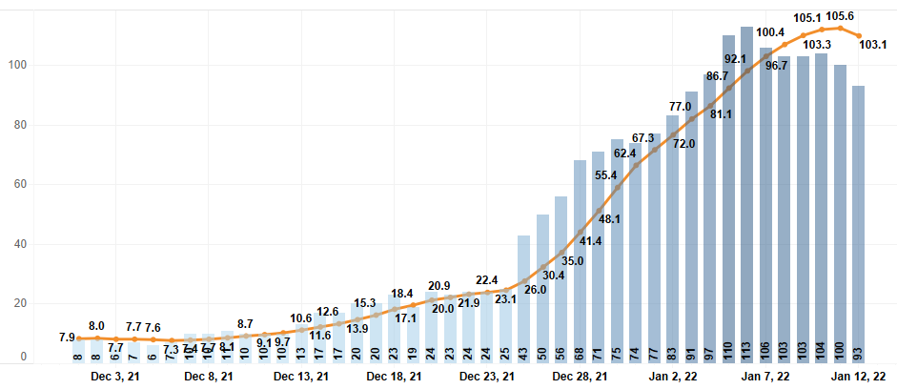
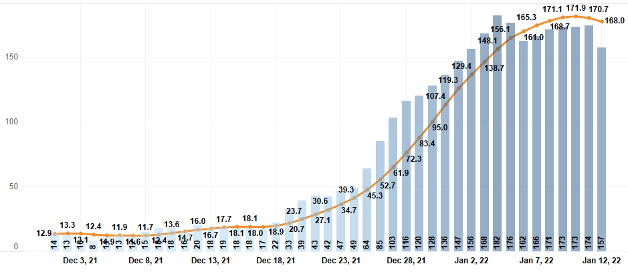
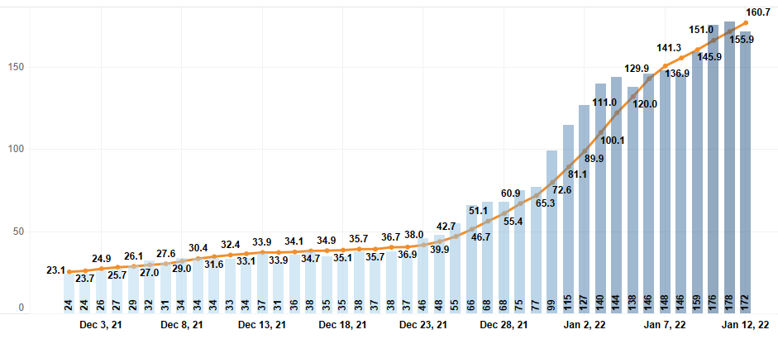
Health + Hospitals Data
Plateauing in COVID-19 hospitalizations
By facility:
Woodhull
Kings County
Coney Island

Slide 16
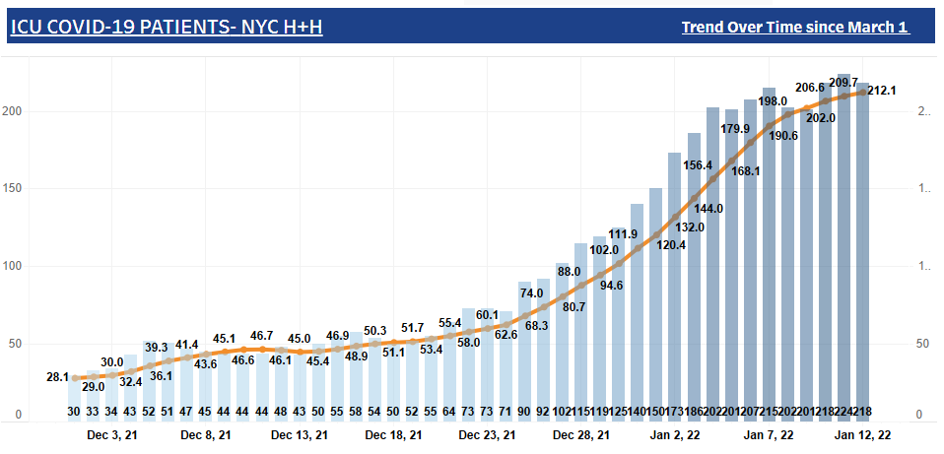
Health + Hospitals Data
ICU COVID-19 admits is plateauing but has not yet fully peaked.
Only 1 in 10 COVID-19 admits is admitted to ICU.

Slide 17
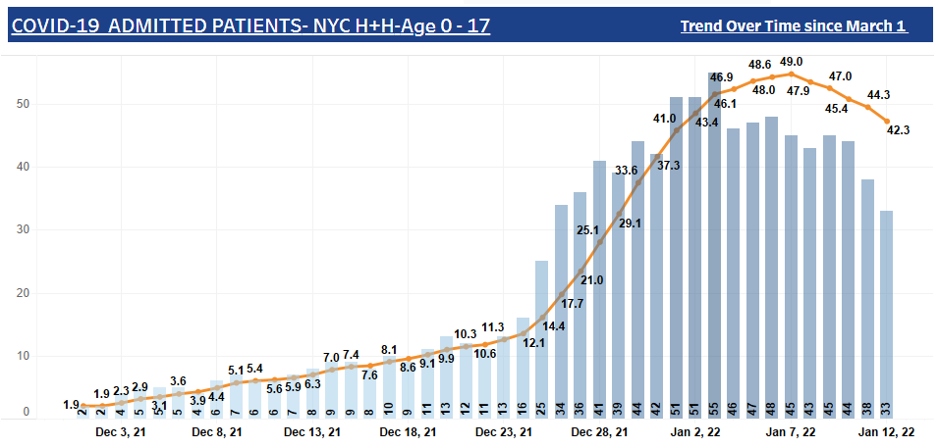
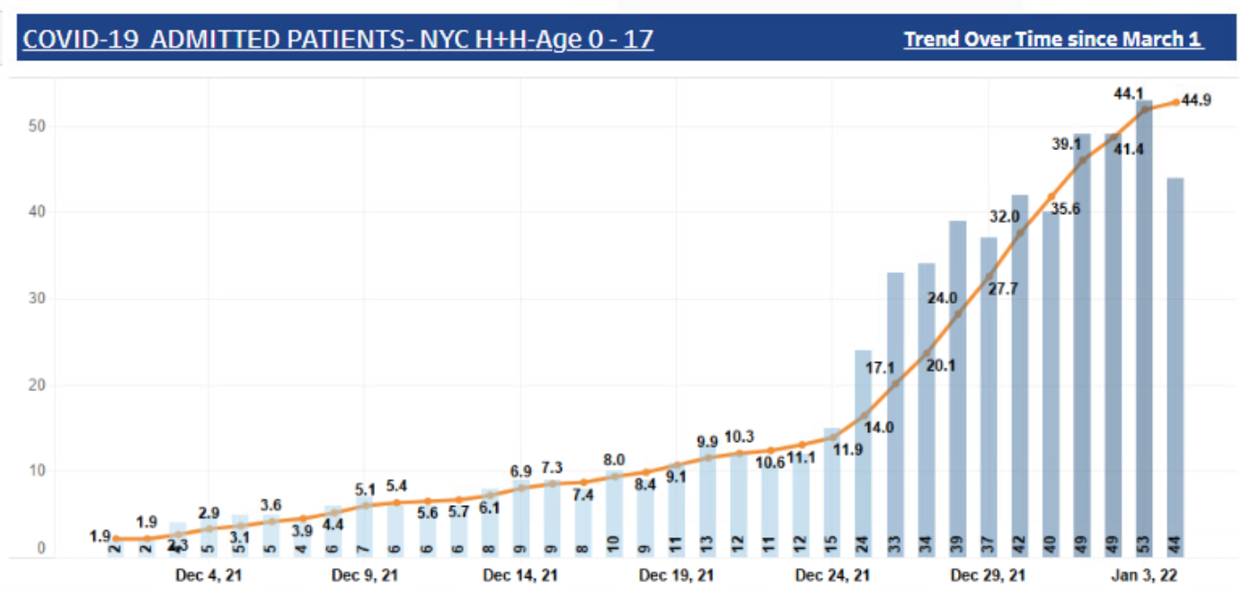
Health + Hospitals Data
Pediatric COVID admissions have risen in proportion to overall COVID admissions
  Appear to be leveling, but will monitor for effect of return to school

Slide 18
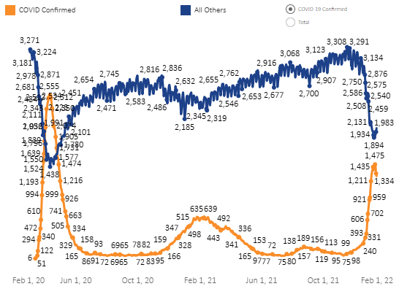
Health + Hospitals Data
As COVID-19 admissions have risen, non-COVID admissions have fallen:
  Hospital avoidance (small effect)
  Chronic diseases flaring now due to COVID and not other causes
    Example: Diabetes
  COVID-19 detected in people admitted for other reasons
    Example: Trauma
However, in the last few days this has begun to reverse…

Slide 19
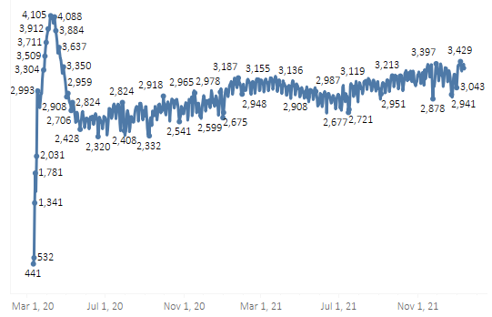
Health + Hospitals Data
Net effect is that overall hospital census remains high and has not yet declined to pre-wave levels

Slide 20
Updates on Health + Hospitals Response

Slide 21
Updates on Health + Hospitals Response
  Several new large surge units have opened in the last week
  Hospitals have been receiving arrivals of external agency staff
  Preliminary approval of federal staffing support to select hospitals
  Discharges have kept pace with admissions
    Continued opportunities to leverage LTACH and SNF beds, isolation hotels

Slide 22
Reminder: Reduce Risk of Staff Infection
  Staff safety is everyone’s responsibility:
    N95/Tightly fitting surgical mask + Eye protection
    Hand-face hygiene
    Breakroom etiquette
  At times uncomfortable, but it’s the best way to:
    Protect yourself/others
    Reduce staff strain in all settings
  Everyone needs to do their part; the end is not far off

Slide 23
Thank you to all of you
for your tireless work,
service, and sacrifice.
You truly are heroes.

Slide 24
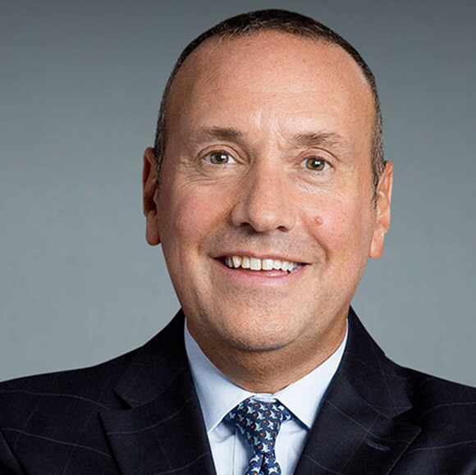
COVID-19 Update: New Outpatient Treatments and Booster Shot Guidance
Dr. Andrew Wallach, Chief Medical Officer for Ambulatory Care

Slide 25

COVID-19 Booster
  January 7th
  Governor Hochul announced that New York’s existing health care vaccination mandate will be expanded to require health care personnel to receive booster shots
  January 11th
  NYS Public Health and Health Planning Council approved

Slide 26
COVID-19 Booster
  Requirement for booster when you are eligible:
    Staff who completed the Pfizer-BioNTech or Moderna initial vaccine series at least five months ago
    Staff who are at least two months past the single-dose Janssen/Johnson & Johnson vaccine

Slide 27
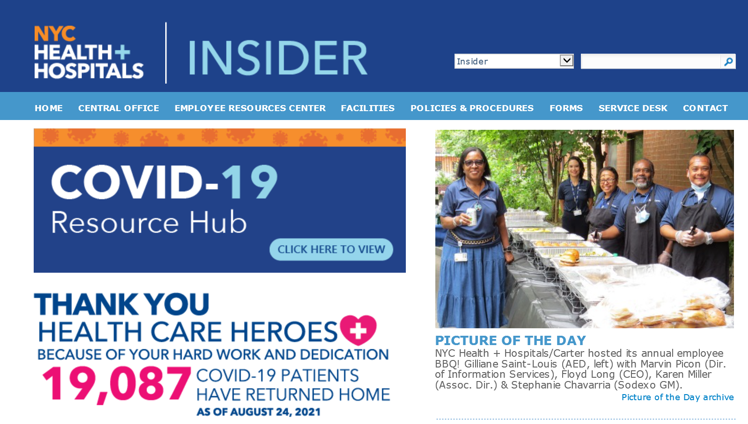

COVID-19Booster
  Availability
    Acutes: Pfizer and Johnson & Johnson
    Gotham: Moderna
    NYC Health + Hospitals staff will be prioritized
      Walk-in or schedule an appointment
  Safe, effective and no cost!
CLICK HERE
THEN, CLICK HERE

Slide 28

COVID-19 Booster
  Documentation
    If you got your booster at a NYC Health + Hospitals facility
      Nothing more to do!
    If you got your booster outside of NYC H+H, please upload
CLICK HERE
THEN, CLICK HERE

Slide 29
COVID-19 Booster
  Time and Leave
    Up to 4 hours excused time during work time to get a booster shot
    Earn 3 hours of comp time after booster shot

Slide 30

COVID-19 Booster

Slide 31
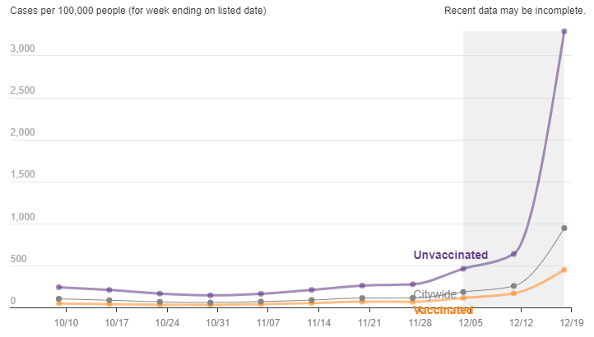
NYC COVID-19 Cases

Slide 32
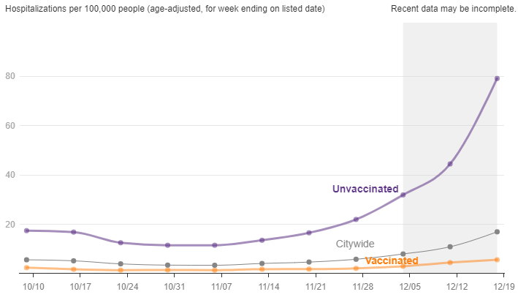
NYC COVID-19 Hospitalizations

Slide 33
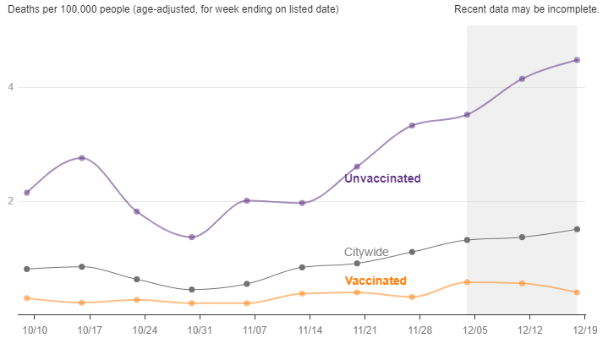
NYC COVID-19 Deaths

Slide 34
Get Your COVID-19 Booster
NOW!

Slide 35

Workforce Wellness Update
Helping Healers Heal Programming
Helping Healers
Heal | H3
January 13, 2022
Thursday
Jeremy Segall, MA, RDT, LCAT
Assistant Vice President
System Chief Wellness Officer
Office of Quality & Safety
NYC Health + Hospitals | Central Office

Slide 36


Your Definition of Wellness
What does health and wellness look, feel, and act like for you this year?

Slide 37
Finding Love, Compassion, & Empathy
“I have decided to love. If you are seeking the highest good, I think you can find it through love.”
“If I stop to help this man, what will happen to me? But… the good Samaritan reversed the question: If I do not stop to help this man, what will happen to him?”
“It takes empathy, patience and compassion to
overcome anger, hatred and resentment.”
Dr. Martin Luther King Jr.

Slide 38

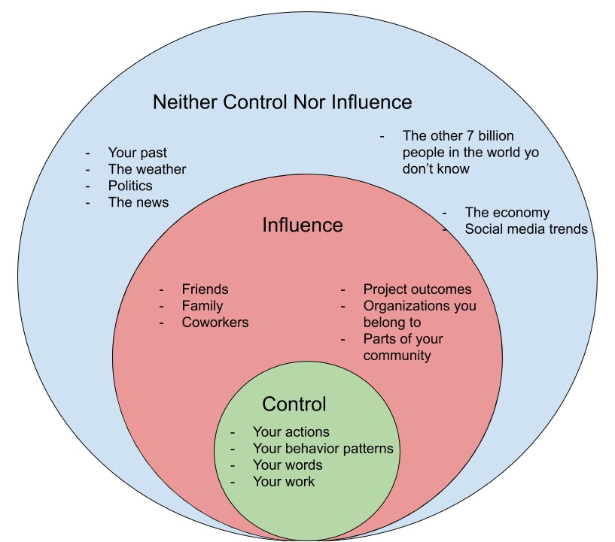
Control What You Can
COVID-19
The economy
Social media

Slide 39
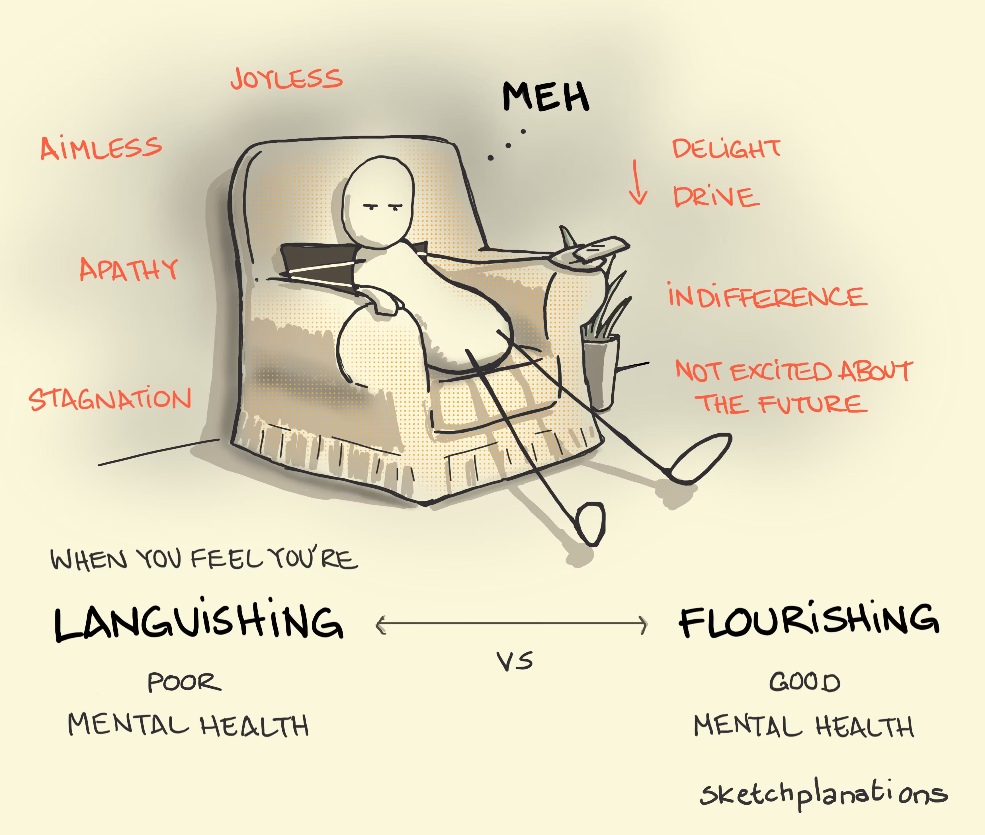
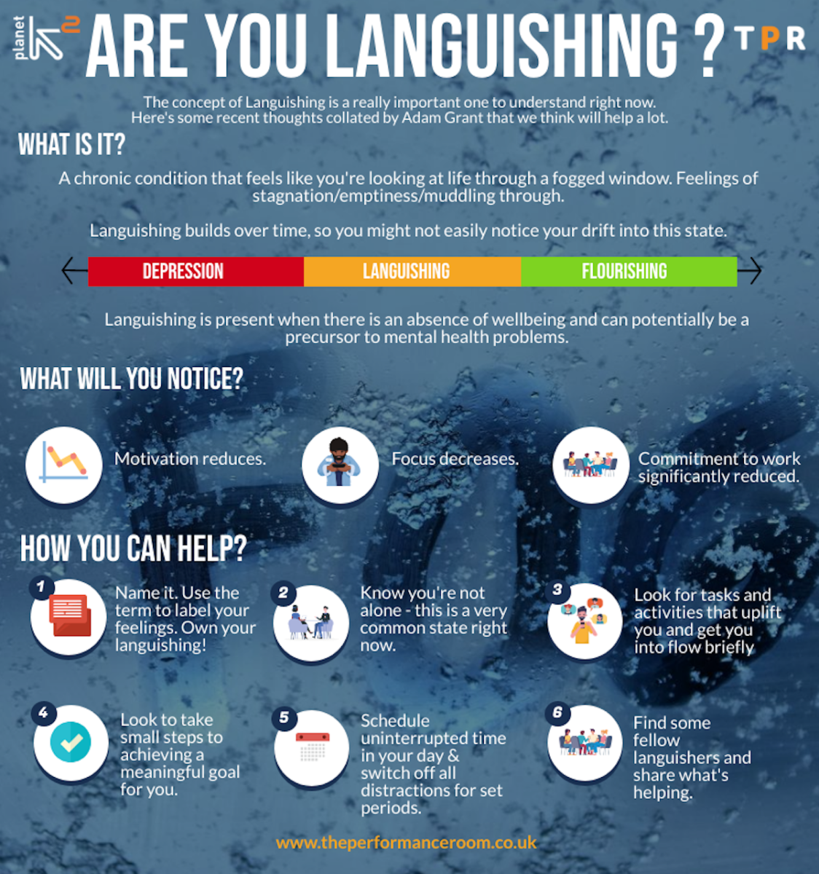
Languishing

Slide 40
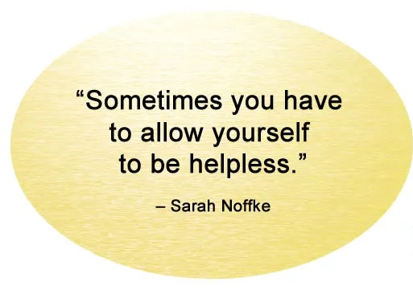


Helplessness

Slide 41
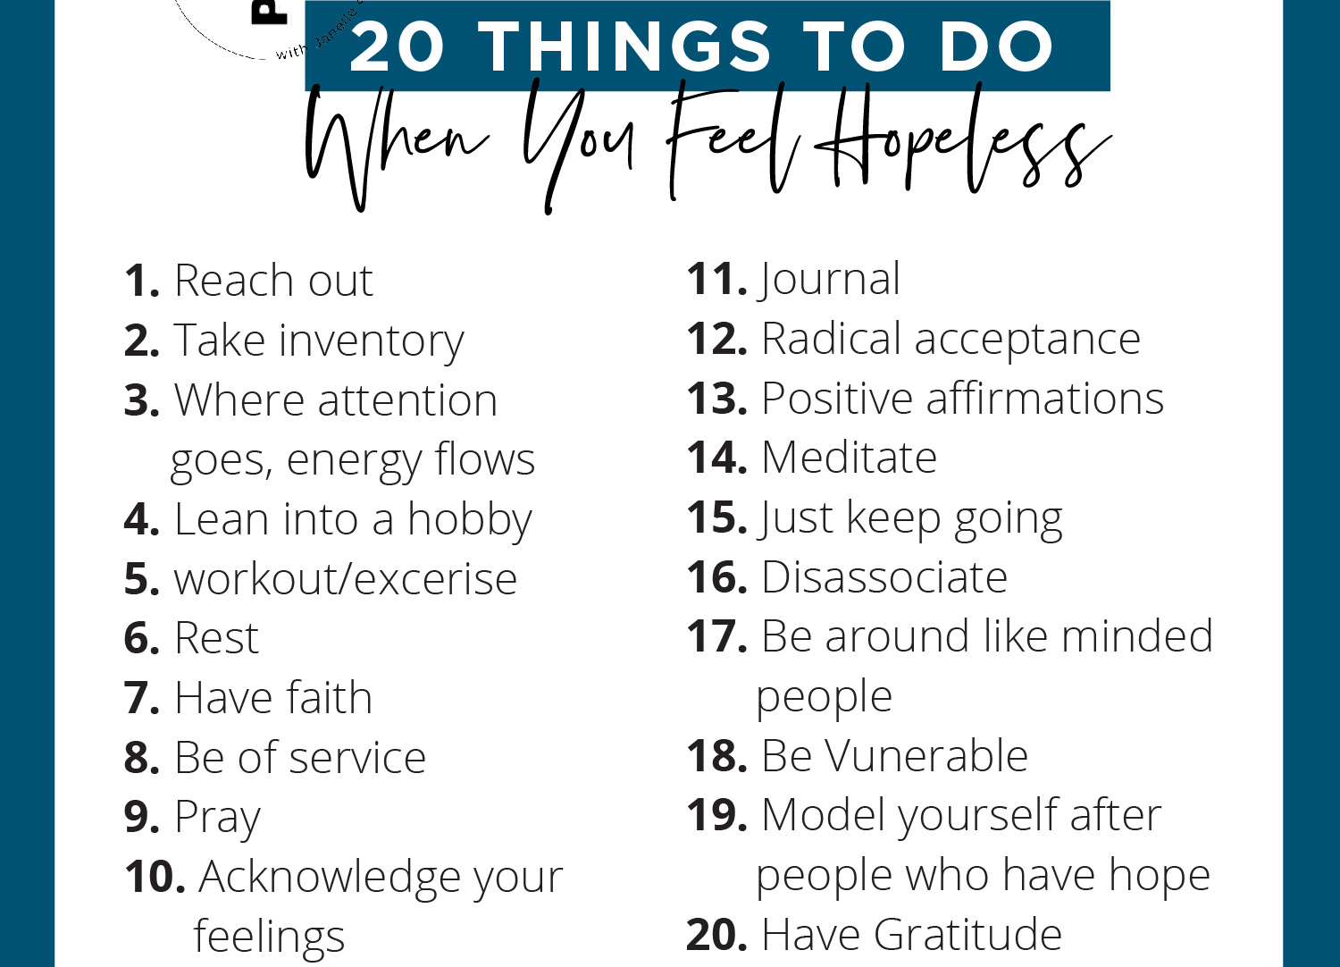
Hopelessness
Workout/exercise
Notes:
The future isn’t set in stone
Time does help
Nothing in life is final, until it is over
It is hard to see solutions when in distress
You are not alone
We have control to make life more meaningful

Slide 42


Overwhelmed

Slide 43
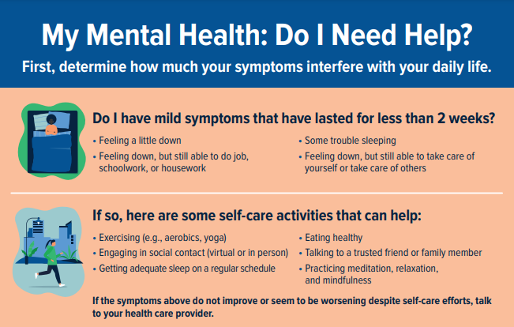

When to Seek Support

Slide 44

Proactive & Preventative H3 Wellness
Notes:
Self-awareness
Rest and recuperation thorugh self-care
Shared perceptions and storytelling in a way that brings us togetherhopefullnes
Optimism and gratitude

Slide 45

Holistic Well-being Programming
Emotional
Environmental
8 Dimensions of H3 Wellness
H3 Evolution
H3 holistic wellness programming has evolved over the last few years and continues to address the emotional and psychological needs of our staff through debriefs, including, but not limited to: acute reaction to unanticipated and adverse work-related events, reaction to stress, secondary, vicarious, complex, and collective traumatization, as well as compassion fatigue, and burnout
Financial
Intellectual
Occupational
Physical
Social
Spiritual
Notes:
Helping Healers Heal or H3, is the foundational infrastructure for enhanced wellness programming across all service lines of NYC Health + Hospitals to address emotional and psychological needs of all staff
H3 holistic wellness programming has evolved over the last few years and continues to address the emotional and psychological needs of our staff through debriefs, including, but not limited to: acute reaction to unanticipated and adverse work-related events, reaction to stress, secondary, vicarious, complex, and collective traumatization, as well as compassion fatigue, and burnout

Slide 46









8 Dimensions of Wellness
Emotional Wellness
Coping effectively with life and creating satisfying well-being for one’s self
Environmental Wellness
Occupational Wellness
Understanding how your social, natural and built environments affect your health and well-being
Finding personal satisfaction and feeling valued in one’s work
Financial Wellness
Physical Wellness
Feeling informed with current and future financial well-being including preparing for short/long term goals and emergencies
Acknowledging the importance of physical activity, nutrition, and sleep
Intellectual Wellness
Social Wellness
Recognizing creative abilities and finding ways to expand knowledge and skills
Developing a sense of connection, belonging and support with others
Spiritual Wellness
Discovering a sense of greater purpose and individual meaning
Resources
Emotional | Environmental | Financial | Intellectual | Occupational | Physical | Social | Spiritual
Helping Healers Heal Workwell Anonymous Hotline COVID-19 Resource Page Mental Health Awareness Month | ICARE Diversity & Inclusion | Employee Resource Center Information strategies for student loans, medical bills, spending, investments, & savings | Workforce development JIT Professional improvement training | Wellness Rooms Transcendental Meditation | Workwell NYC EAP | Battle Buddy Staff Appreciation Events | Chaplains Spiritual Council

Slide 47

H3 Contacts
Acute Care Site | H3 Lead | Wellness Program Director (LCSW)
Bellevue | Natalie Kramer Natalie.Kramer@nychhc.org Anne Rugova Anne.Rugova@nychhc.org | Alyson Helfand
Coney Island | Lynn Hussey Lynn.Hussey@nychhc.org Laura Grossman Laura.Grossman@nychhc.org | Rebecca Grodzki
Elmhurst | Suzanne Bentley BENTLEYS@nychhc.org Samantha Warner warners1@nychhc.org Mamie McIndoe MCINDOEM@nychhc.org | Tatiana Celcis
Harlem | Keisha Wisdom wisdomk@nychhc.org Devida Allen Devida.Allen@nychhc.org Mary Caram Mary.Caram@nychhc.org | Gisell Perez Ortiz
Jacobi | Donna Geiss Donna.Geiss@nychhc.org Marni Confino Marni.Confino@nychhc.org
Kings County | Donna Leno-Gordon Donna.Leno-Gordon@nychhc.org Latoya Jackson Latoya.Jackson@nychhc.org
Lincoln | Usha Venugopal Usha.Venugopal@nychhc.org Dina Carter carterd17@nychhc.org | Rhayvan Jackson-Terrell jacksonr28@nychhc.org
Metropolitan | Leonard Davidman Leonard.Davidman@nychhc.org Margie Rivera Deleon Margie.RiveraDelon@nychhc.org Samrina Kahlon Samrina.Kahlon@nychhc.org
North Central Bronx | Yvonne Torres Yvonne.Torres@nychhc.org Kalsang Tshering tsherink@nychhc.org | Dhesiay Tiburcio
Queens | Gail Hirsch HIRSCHG@nychhc.org Jean Fleischman FLEISCHJ@nychhc.org | Bebe Rojan rojanb@nychhc.org
Woodhull | Marlene Dacken Marlene.Dacken@nychhc.org
Post-Acute Care Site | Lead
Carter | Jeannette Rosario Jeannette.Rosario@nychhc.org
Coler | Nelson Cabrera Nelson.Cabrera@nychhc.org Cheryl Dury duryc@nychhc.org Monserrate Nieves-Martinez Monserrate.Nieves-Martinez@nychhc.org
Gouverneur SNF | Emalyn Bravo Emalyn.Bravo@nychhc.org
McKinney | Angela Cooper Angela.Cooper@nychhc.org Daveth Forbes forbesd6@nychhc.org
Sea View | Karen Maiara Karen.Maiara@nychhc.org
Service Line | Lead
Community Care | Emmanuel Monegro monegroe@nychhc.org Ishmael Carter Ishmael.Carter@nychhc.org Brenia De La Cruz-Cedeno delacb3@nychhc.org
Ambulatory Care | Justin List Justin.List@nychhc.org
Notes:
OBH
D & I
Workforce Development
HR / Shared Resources
Communications
DnA & IT

Slide 48

Emotional Wellness
Coping effectively with life and creating satisfying well-being for one’s self

Slide 49

H3 = Holistic Wellness
http://hhcinsider.nychhc.org/sites/helping_healers_heal/Pages/index.aspx

Slide 50
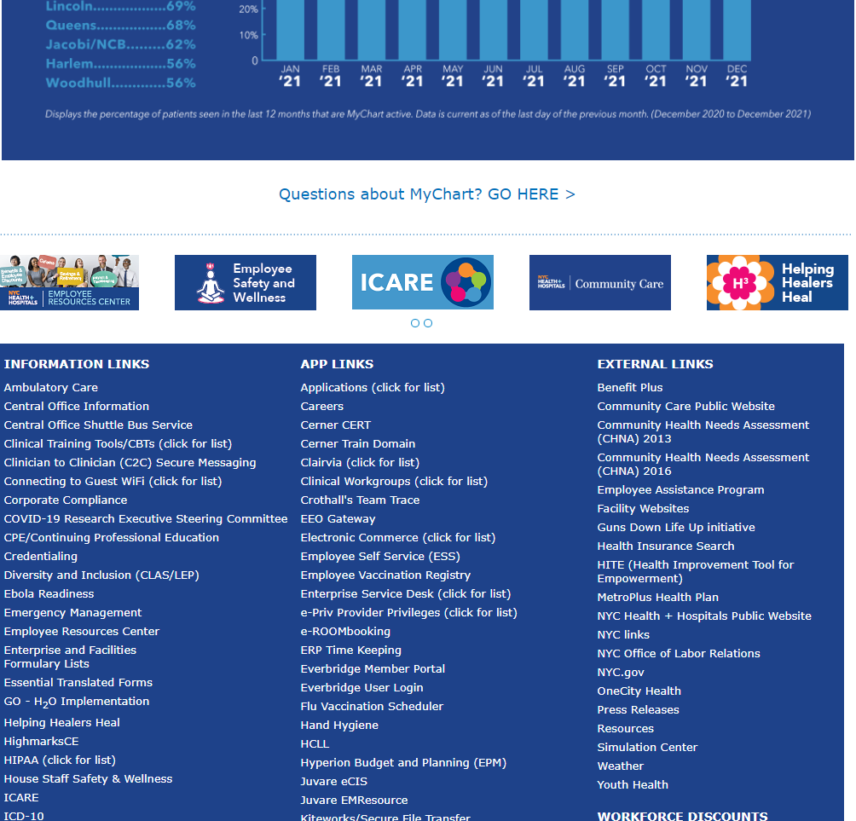
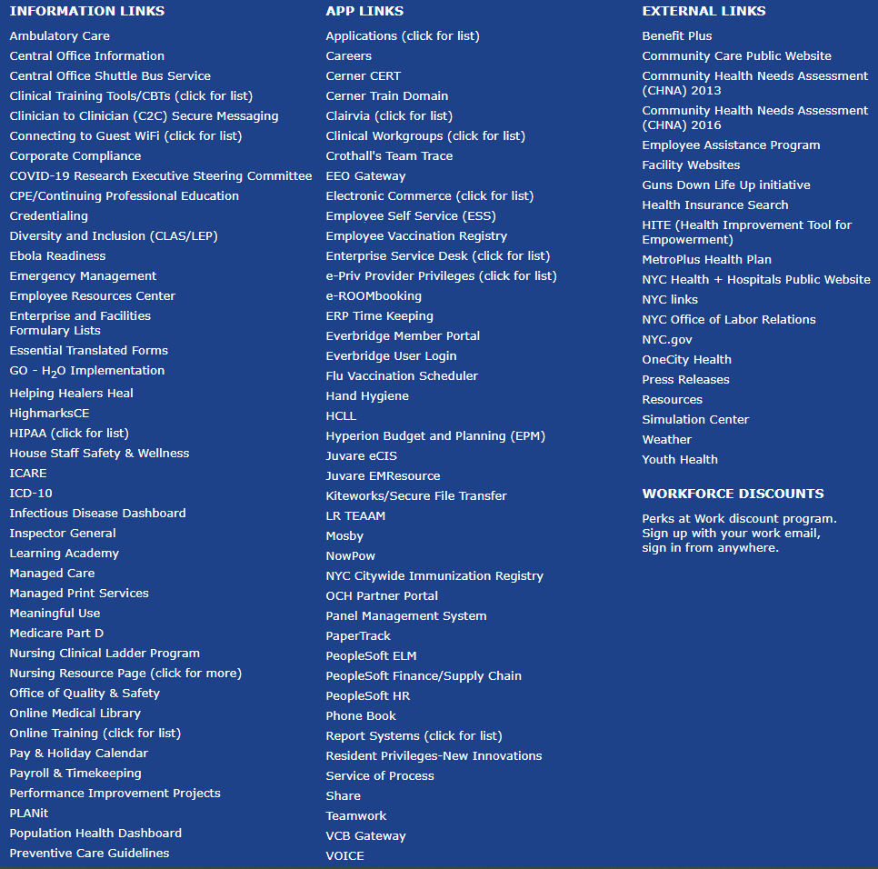
Promoting Wellness

Slide 51
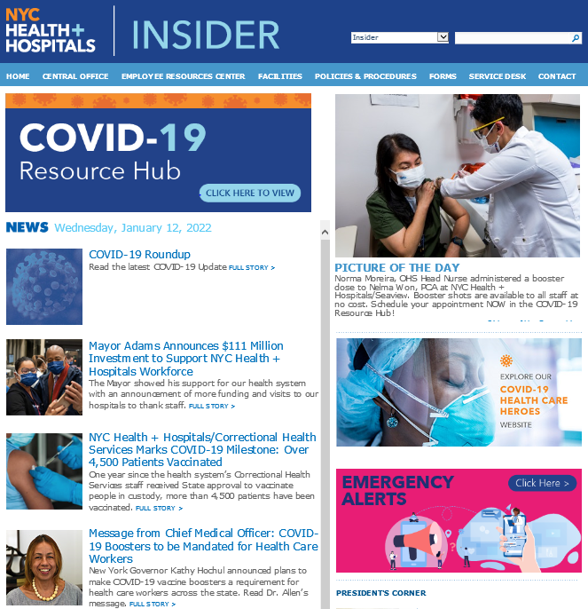
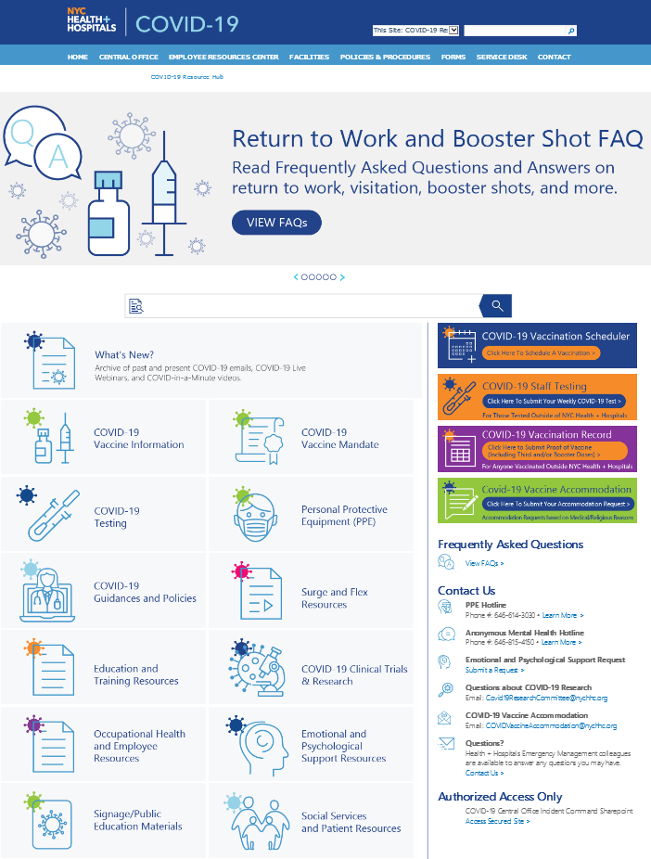
Promoting Wellness
Centralized COVID-19 Wellness Information
Trigger emotional & psychological support response
Find trainings, presentations, and hotline information

Slide 52

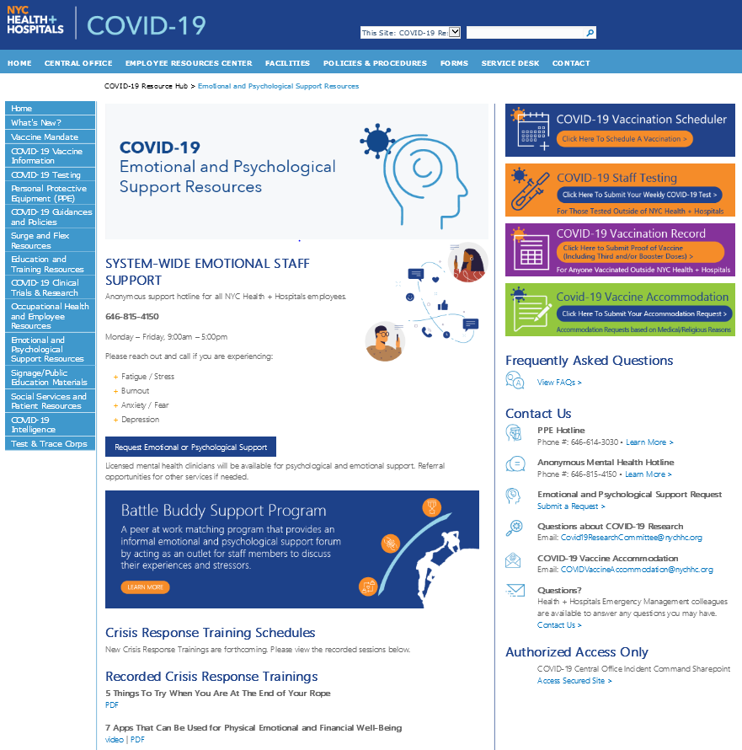
Holistic Wellness Resources
http://hhcinsider.nychhc.org/sites/helping_healers_heal/Pages/index.aspx
https://hhcinsider.nychhc.org/sites/COVID-19/Pages/EPSR.aspx

Slide 53
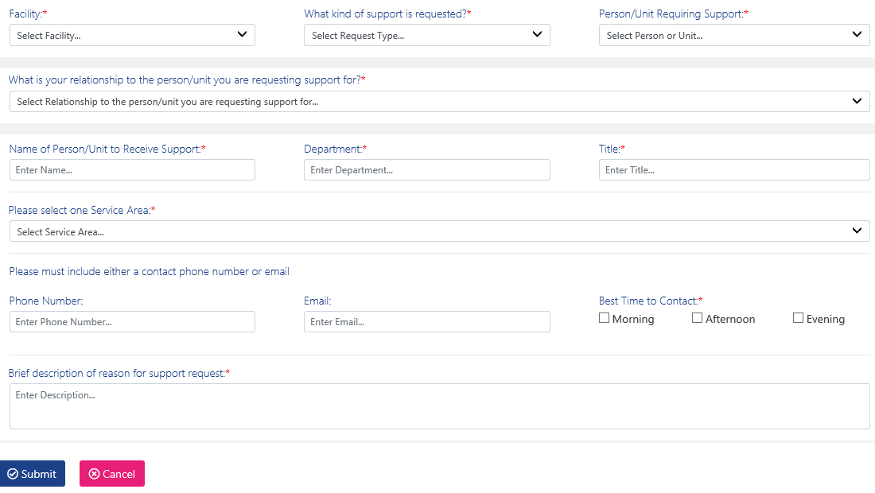
Wellness Request Form
https://h3portal.nychhc.org/
H3 Activation Request Form
Form for staff to use to request support from their local H3 program. Can be used to request support for yourself, a colleague, or an entire team.
http://hhcinsider.nychhc.org/sites/helping_healers_heal/Pages/index.aspx

Slide 54



Resident Wellness
External link:
http://ess.nychhc.org/staff-wellness.html
Internal link:
http://hhcinsider.nychhc.org/corpoffices/erc/hssw/Pages/default.aspx

Slide 55





H3 Wellness Resources
Helping Healers Heal Webpage
COVID-19 Resource Hub Wellness & Resilience Resources
Battle Buddy Support Program
Physician Support Line
All QR codes must be used using devices on Corporate WIFI
Resident/House Staff Wellness Resource Page (Intranet)

Slide 56


Staff Support Hotlines
“Sometimes there's comfort in anonymity…Though no one should ever feel ashamed to take care of their mental health, seeking totally anonymous help can be an easy start for those who prefer to keep things private.” Yohana Desta
Notes:
10 minutes

Slide 57

Assistance for You & Family
Notes:
10 minutes

Slide 58

Grief & Loss Virtual Support Group
https://us06web.zoom.us/j/81435413042?pwd=U2hrNGdyU0p6aHQzZ3l6MlRFLzVXQT09
Notes:
10 minutes

Slide 59



NYC Trauma Recovery Network
WHAT IS EMDR?
Eye Movement Desensitization and Reprocessing (EMDR) is a psychotherapy approach that was designed to treat trauma, by alleviating the distress associated with traumatic memories. It is a short-term therapy where processing every detail of the incident is not necessary in order to heal and have relief. Research has shown that EMDR is an effective treatment for Post-Traumatic Stress Disorder (PTSD). EMDR is a treatment approach which has been empirically validated in over 30 randomized studies of trauma victims and is recommended as an effective treatment for trauma by the World Health Organization, the American Psychiatric Association, and the Department of Veterans Affairs and Department of Defense. For more information about EMDR please visit the EMDR International Association website.
10 Free Sessions
Click Here to Attain Support
or call (212) 949-0381
Notes:
10 minutes

Slide 60
Environmental Wellness
Understanding how your social, natural, and built environments affect your health and well-being

Slide 61


H3 Wellness Rooms
Notes:
Prime real estate
Investment in permanence

Slide 62

Improved Wellness Rooms
Notes:
Prime real estate
Investment in permanence

Slide 63

ICARE Values
I
C
A
R
E
We invite you all to take the time to help realign you with your meaning and purpose in working at NYC Health + Hospitals. Strong alignment with the ICARE model can help us navigate through another challenging year, continue to provide a favorable care experience to our patients and support one another. We will be reminded of how our work ultimately impacts our patients, no matter how we touch their lives.
ICARE Refresher E-Learning Course
Log into PeopleSoft ELM and click on “My Learning” to access the ICARE Refresher e-learning course.
OR
Self-enroll into the course by searching for “ICARE Refresher” in PeopleSoft ELM.
Bi-Weekly ICARE Tips
Receive an email from ICARECorp@nychhc.org including novel tips to embody ICARE values in our day-to-day tasks as we interact with care providers and caregivers.
OR
Email CentralCareExperience@nychhc.org to join the email distribution list to receive bi-weekly ICARE tips.
Notes:
Prime real estate
Investment in permanence

Slide 64


Diversity & Inclusion
How to be an Upstander
Jan. 13 (Thurs), 2-3 p.m.
Learn techniques to address racism and become a better ally.
Diversity and Inclusion in a Healthcare Setting
Jan 21 (Fri), 12:30-2:00 p.m. | Feb 7 (Mon), 12-1:30 p.m.
Learn strategies to address unconscious bias and provide culturally responsive care.
Health Literacy Training for Clinicians
Jan 26 (Wed), 12-1:30 p.m. | Feb 25 (Fri), 12-1:30 p.m.
Hear about skills to improve communication with patients, including using plain language, recognizing health literate materials, and practicing the teach-back method.
Interreligious Awareness for Patient-Centered Care Part I
Jan 31 (Mon), 12:30-1:30 p.m. | Feb 24 (Thurs), 1-2 p.m.
Examine skills to meet patients’ religious/spiritual needs and to respectfully interact with colleagues from different faith backgrounds.
Achieving Health Equity for LGBTQ People
Jan 25 (Tues), 12-1 p.m. | Feb 15 (Tues), 12-1 p.m.
Learn key concepts and terminology, gain insight on LGBTQ health disparities and best practices when working with LGBTQ patients.
Having Essential Conversations
Feb 3 (Thurs), 2-3 p.m.
Learn tips, tools, and techniques for holding essential conversations — including how to establish ground rules, create safe spaces, understand hot buttons, and how to encourage open dialogue.
Click here to register for any of these sessions using the new training scheduler. Click here to access the flyer for these trainings, and here to download a flyer of the Office’s ELM trainings.
diversity@nychhc.org.
Notes:
Prime real estate
Investment in permanence

Slide 65
Social Wellness
Developing a sense of connection, belonging and support with others

Slide 66


Battle Buddy Support Program
https://battlebuddy.nychhc.org

Slide 67

Childcare Services
Bright Horizons enrollment is open now through January 26 for all NYC Health + Hospitals employees who need childcare support during the pandemic surge.
Staff who apply and are verified will receive access to the program, and will have the option to receive care within the next thirty (30) days.
Enrollees are responsible for the copayments associated with care.
Space is limited and available on a first come, first served basis. Program is subject to change based on availability.
Email: childcareservices@nychhc.org
Center-Based Care: | $20 co-pay per day for the first child, and $35 co-pay per day for two or more children attending the same center.
In-Home Care: | $8 co-pay hour for up to 10 hours of use. Per-hour rate is up to three children in the child care provider's care.
Childcare Services Team at Human Resources
https://covid19.nychealthandhospitals.org/ChildCareEnroll
Click here for: FAQ
Notes:
The Childcare Services Team at Human Resources & Office of Diversity & Inclusion

Slide 68
Physical Wellness
Acknowledging the importance of physical activity, nutrition, and sleep

Slide 69


Nurturing your Body
Move Towards Well-being
https://www1.nyc.gov/assets/olr/downloads/pdf/wellness/workwell-fitnesscalendar.pdf

Slide 70




Nurturing your Body
Move Towards Well-being
Anyone can receive program schedules directly in their inbox by visiting:
on.nyc.gov/mailinglist
95% of programming can be found at
https://vimeo.com/workwellnyc
for anytime viewing post-event
50+ fitness classes scheduled weekly Classes can be found at: on.nyc.gov/wellnesscalendar ​

Slide 71

Financial Wellness
Feeling informed with current and future financial well-being including preparing for short/long term goals and emergencies

Slide 72

Financial Sustainability
Wednesday, January 12 | 12:00 PM - 1:00 PM & 6:00 PM - 7:00 PM | TDA Overview - Presented by TDA Retirement Counselors | Employees will learn about the TDA (403b) plan highlights and benefits, the importance of saving, why start saving now, along with the tools and resources available to them.
Wednesday, January 26 | 12:00 PM - 1:00 PM & 6:00 PM - 7:00 PM | Five Steps to Retirement Readiness - Presented by TDA Retirement Counselors | Retirement planning has five steps: knowing when to start, calculating how much money you'll need, setting priorities, choosing accounts and choosing investments. Our aim with this retirement planning guide is to help you achieve that goal.
Check out the Learning Academy on the Insider to see other courses.
Contact: MyLearning@nychhc.org
Website: hhlearning.nychhc.org

Slide 73

Intellectual Wellness
Recognizing creative abilities and finding ways to expand knowledge and skills

Slide 74



Just-in-Time Training
Click here for the Wellness Just-in-Time Training Portal
Just-in-Time Trainings
Trainings for staff centered around Emotional, Environmental, Occupational, Physical, Spiritual, Intellectual, Financial & Social well-being
Notes:
Make sure to reach out to your local H3 lead to discuss the submitting of the H3 Encounter Form
Just to assure folks that there is no MRN linked or medical record and that this is a peer support service. Jeanette Baxter generally presented this piece. That was the piece that generally gave many people reservations about doing debriefings.

Slide 75




Knowledge is Power
http://hhcinsider.nychhc.org/sites/COVID-19/Pages/EPSR.aspx
Notes:
Melody

Slide 76

Trainings Available
Anytime, Anywhere
Click “Video” under the Training title you want to view
The video recording will automatically download
Once download is complete, click the file and it will open for viewing
Scroll towards the bottom of the page to find Recorded Crisis Response Trainings
Notes:
Melody

Slide 77

Occupational Wellness
Finding personal satisfaction and feeling valued in one’s work

Slide 78

Recognition = Resilience
437M
surveys sent annually
78% of employees respect the abilities of the individual to whom they report.
78% of employees feel respected by their direct manager.
62% of respondents feel there is a climate of trust and feel respected by the organization.
56% of employees are satisfied with the recognition they receive for doing a good job.
90% of employees believe their work is meaningful.
67% of employees feel valued by the organization.
2021 H+H Employee Feedback Survey (n = 13,177)

Slide 79




Resilience is Wellness
We Value YOU
YOU Value Yourself
Reflect Back Value of Others
Purpose + Positivity + People = Resilience

Slide 80
Spiritual Wellness
Discovering a sense of greater purpose and individual meaning

Slide 81



Moral Injury
Moral Injury: the perpetrating, inability to prevent, or witnessing of events that challenge deeply held personal morals, beliefs, values or societal expectations that negatively impacts your well-being.
Diagram by: Dr. William Nash
Copyright ©2021 R. Stevens / CREST (CC BY-SA 4.0)
Notes:
Challenges to what we consider “integrity” to be that causes psychological, spiritual, and psychological consequences and negative feelings states
Generally seen as experiencing “immoral acts” creating an emotional wound causing internal conflict

Slide 82
Lift the Spirit
Contact your local Spiritual Care department or Chaplain
The experience of responding to adversity can alter religious and spiritual beliefs
Change in relationship with or belief about God/Higher Power
Abandonment of spiritual practice
Inability to practice due to workload issues or social distancing
Questioning beliefs or loss of faith
Rejection of spiritual care providers
Struggle with questions about the meaning of life, justice, fairness, afterlife
Loss of familiar spiritual supports
Thoughts
Behaviors
Emotions
Situation
Spiritual
Physical
Sources: Disaster Mental Health Standards and Procedures, The National American Red Cross, December, 2016

Slide 83

Fight the Stigma
Stop Stigma, Start Healing

Slide 84

Thank You

Slide 85
Questions

Slide 86
What are the side-effects from a booster dose?

Slide 87


