Slide 1
[insert facility name]
Infection Prevention and Control
COVID-19 Education
[insert names of presenters]

Slide 2
This presentation will provide a review of:
Infection Prevention Basics
  Hand Hygiene
  Standard Precautions and Transmission-based precautions
  Cleaning and disinfection
COVID-19 PPE Guidance
  PPE Grid by Location
  Guidance Posters
  Extended Use and Reuse
  Donning and Doffing Procedures
Preventing Cross Contamination & Breakroom Etiquette
Notes:
This goal of this training is to ensure staff are provided with a refresher on infection prevention basics and strategies related to COVID-19.

Slide 3
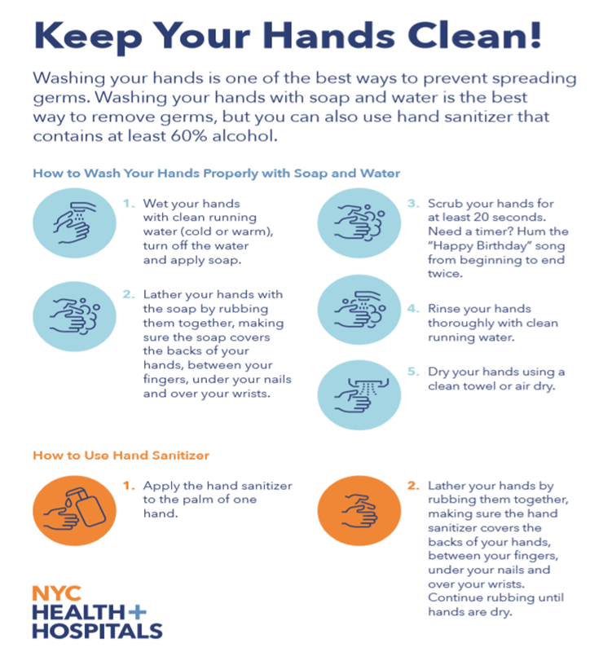
Hand Hygiene
CDC recommends using ABHR with 60-95% alcohol in healthcare settings.
Hands should be washed with soap and water for at least 20 seconds when visibly soiled, before eating, and after using the restroom. Learn more about hand hygiene in healthcare settings.
Notes:
Hand hygiene is one of the simplest strategies that plays a huge role in preventing the spread of infection. While it’s simple, there is still a method to doing so and key areas around your hands are not missed, such as over the wrists, between the fingers, and under the nails.
(Explain the process for using hand sanitizer and hand washing.)

Slide 4
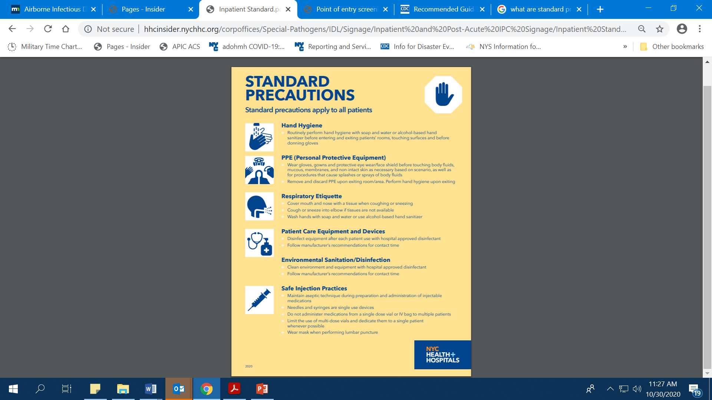
Standard Precautions are the basic level of infection prevention practices that apply to all patient care, regardless of suspected or confirmed infection status of the patient, in any setting where health care is delivered.
Standard precautions are designed to reduce the risk of transmission of bloodborne and other pathogens from both recognized and unrecognized sources.
Hospital infection is the result of a combination of factors: Microbial Source + Transmission + Susceptible Host = Infection
Notes:
Explain each category
Hand Hygiene
PPE – the types
Definition of Respiratory Etiquette
Explain how to clean and disinfect Patient Care Equipment and Devices after EACH use.
When to clean and disinfect the environment
Define Safe Injection Practices – may read off of the signage.

Slide 5
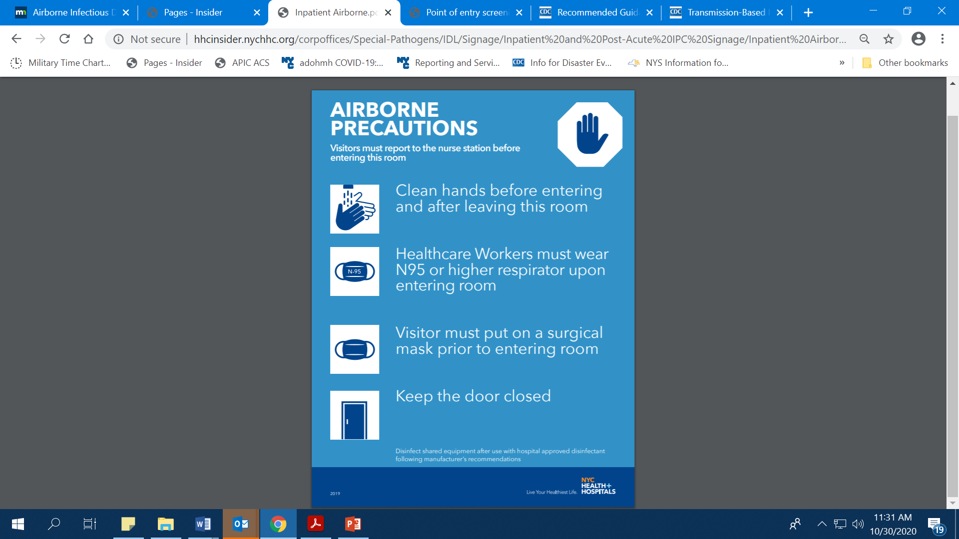
Transmission Based Precautions
Transmission-Based Precautions are the second tier of basic infection control and are to be used in addition to Standard Precautions for patients who may be infected or colonized with certain infectious agents for which additional precautions are needed to prevent infection transmission.
Transmission based precautions are based on the route of transmission of the microorganism
  Contact Precautions
  Enhanced Contact Precautions
  Droplet Precautions
  Airborne Precautions
Notes:
The different types of transmission based precautions used at H+H are: Contact, Droplet, Airborne, and a combination of them, based on the specific infectious disease. For COVID-19, either Droplet + Contact + Eye protection or Airborne + Contact + Eye protection, depending on the patient care area. Airborne + Contact + Eye protection is used by everyone in the room for every aerosol generating procedure.
Next, we’ll break down each item of PPE.

Slide 6
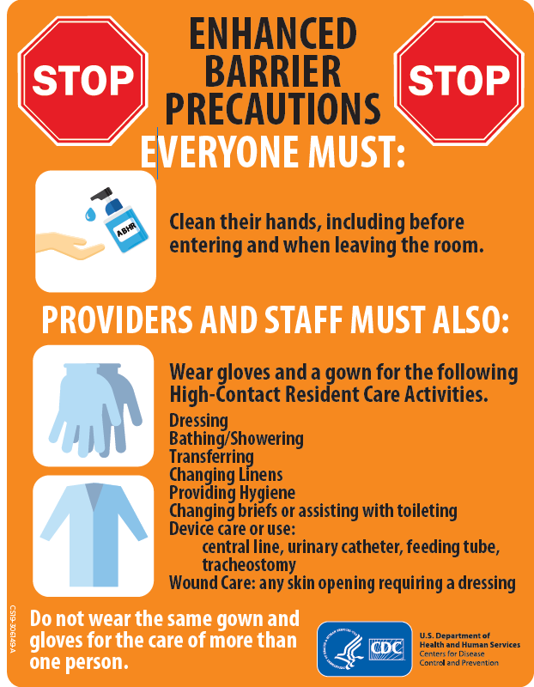
Enhanced Contact Isolation for Long Term Care
Enhanced Barrier Precautions requires gown and glove for use for certain residents in Long Term Care Settings during specific high-contact resident care activities if residents are colonized or infected with targeted multi-drug resistant organisms (MDROs).
Targeted MDROs are defined as:
Pan-resistant organisms
Carbapenemase-producing Enterobacteriaceae
Carbapenemase-producing Pseudomonas spp.
Carbapenemase-producing Acinetobacter baumannii
Candida auris
Notes:
SKIP THIS SLIDE IF YOUR FACILITY IS NOT LTC

Slide 7
Enhanced Contact Isolation for Long Term Care
Enhanced Barrier Precautions expand the use of PPE beyond situations in which exposure to blood and body fluids is anticipated and refer to the use of gown and gloves during high-contact resident care activities that provide opportunities for transfer of multidrug resistant organisms to staff hands and clothing.
High-contact resident care activities requiring gown and glove use include:
Dressing
Bathing/showering
Transferring
Providing hygiene
Changing linens
Changing briefs or assisting with toileting
Device care or use: central line, urinary catheter, feeding tube, tracheostomy/ventilator
Wound care: any skin opening requiring a dressing
Gown and gloves would not be required for resident care activities other than those listed above, unless otherwise necessary for adherence to Standard Precautions.
Notes:
SKIP THIS SLIDE IF YOUR FACILITY IS NOT LTC
Next, we’ll break down each item of PPE.

Slide 8
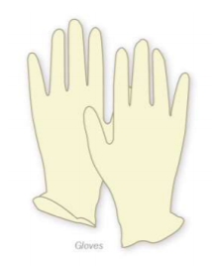
Gloves
Wear gloves that fit appropriately.
(Select gloves according to hand size)
Do not wear the same pair of gloves between patients.
Do not wash gloves for the purpose of reuse.
Remove gloves after each patient contact.
Perform hand hygiene immediately after removing gloves.
Gloves do not replace hand hygiene.

Slide 9
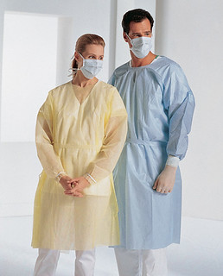
Gowns
Gowns are used as barrier protection between the patient/environment and the healthcare worker.
Gowns are single use only.
Notes:
Gowns should be used when taking care of persons under investigation (PUIs) or COVID-19 positive patients. Gowns should also be worn if anticipating contact with blood and/or body fluids.

Slide 10
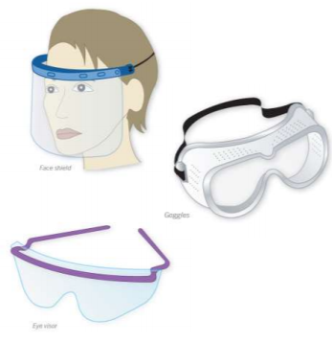
Eye Protection
Protective eye wear is required for all patient encounters.
Wear eye protection to protect mucous membranes from droplets which may be present when in close contact with a patient.
Personal eyeglasses and contact lenses are not considered adequate eye protection.
Notes:
Eye protection must be worn for EVERY patient contact.

Slide 11
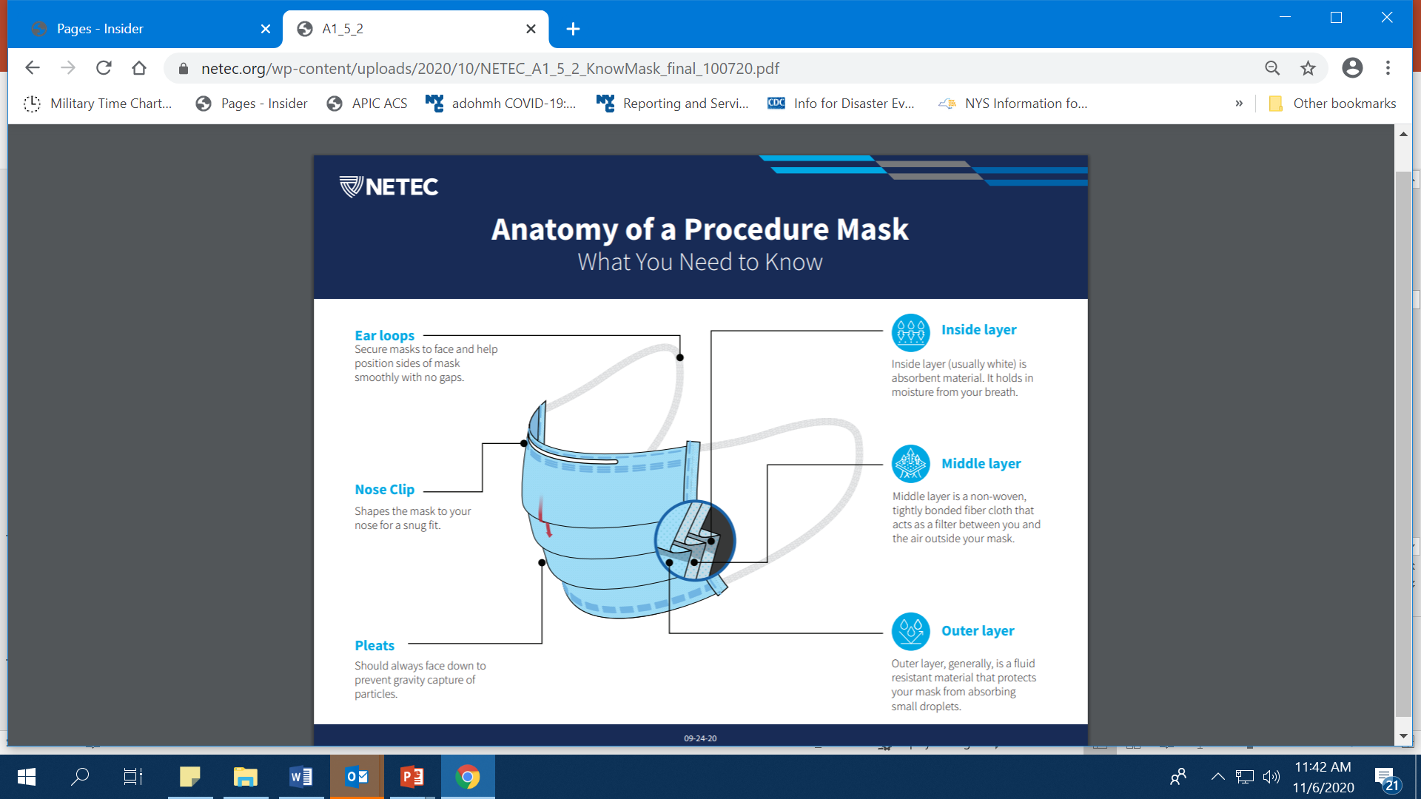
Facemask
Surgical/procedure masks are disposable devices that creates a physical barrier between the mouth and nose of the wearer and potential contaminants in the immediate environment
Helps block large-particle droplets, splashes, sprays, or splatter that may contain germs (viruses and bacteria), keeping it from reaching your mouth and nose.
Helps reduce exposure of your saliva and respiratory secretions to others.
Notes:
Surgical or procedure facemasks, supplied by H+H, are required upon entrance to all healthcare facilities. Cloth masks cannot be worn by healthcare personnel.

Slide 12
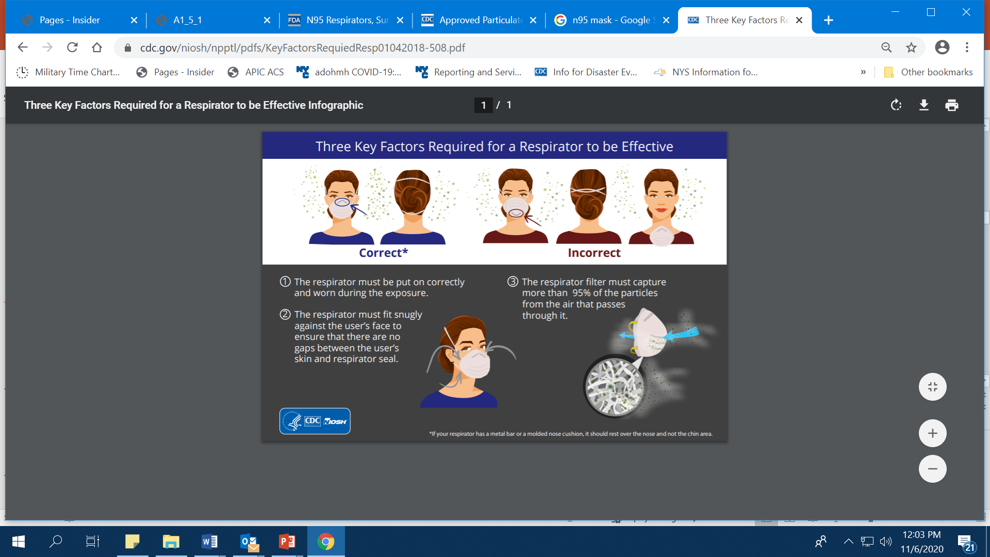
N95 Respirator
Designed to achieve a very close facial fit for efficient filtration of airborne particles.
The edges of the respirator are designed to form a seal around the nose and mouth.
N95 respirators are not designed for people with facial hair due to difficulty in achieving a tight seal. A PAPR or CAPR may be used as an alternative.
Notes:
Everyone must be fit-tested for the type of N95 Respirator they are wearing. If a new brand or type of N95 is introduced on your unit, you must be fit-tested before you can wear the N95 Respirator.
If you fail the fit-test, you will be given the option to wear a PAPR or CAPR.

Slide 13
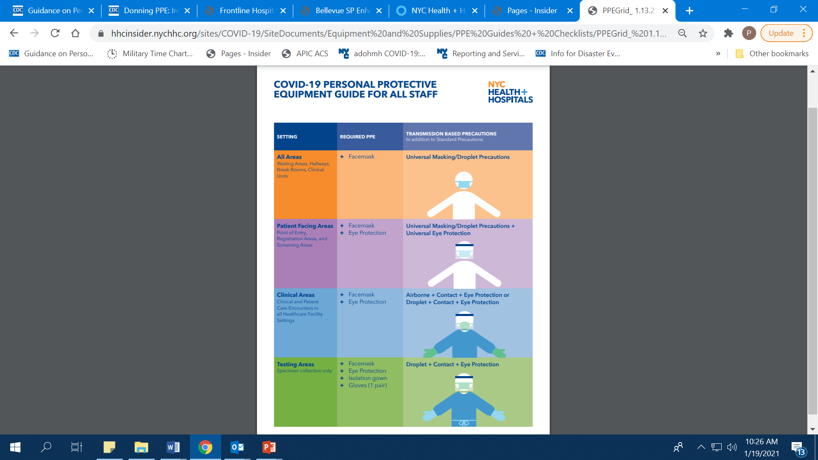
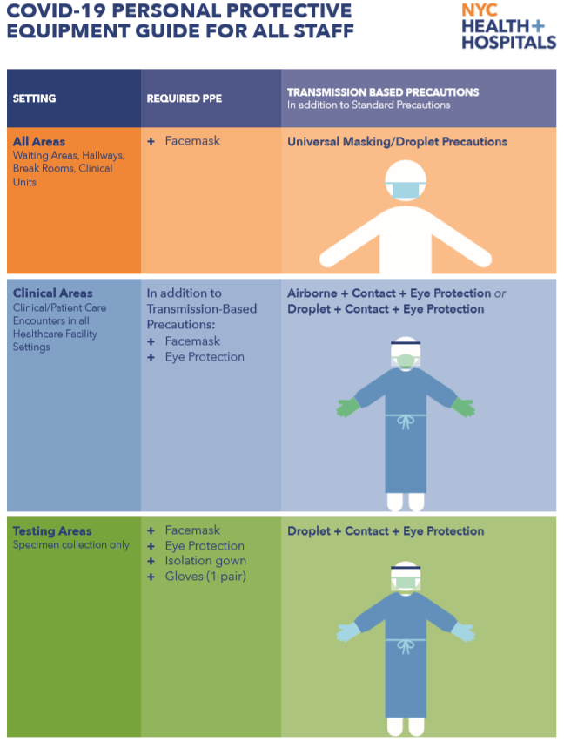
COVID-19 PPE Grid by Location for All Staff
Notes:
The COVID-19 PPE Grid by Location is broken down by 4 settings: All Areas; Patient Facing Areas; Clinical Areas; Testing Centers.
All healthcare personnel and staff must practice universal masking in all areas of the workplace.

Slide 15
Notes:
Staff in clinical areas must practice universal masking and eye protection, in addition to following specific transmission based precautions.
For example, if caring for a patient with an MDRO who is on Transmission-Based Precautions, clinical staff should wear an isolation gown in addition to mask and eye protection.

Slide 16
Notes:
When collecting specimens for COVID-19 testing in testing areas, staff should follow droplet + contact + eye protection precautions; a surgical or procedural mask and protective eyewear.

Slide 17
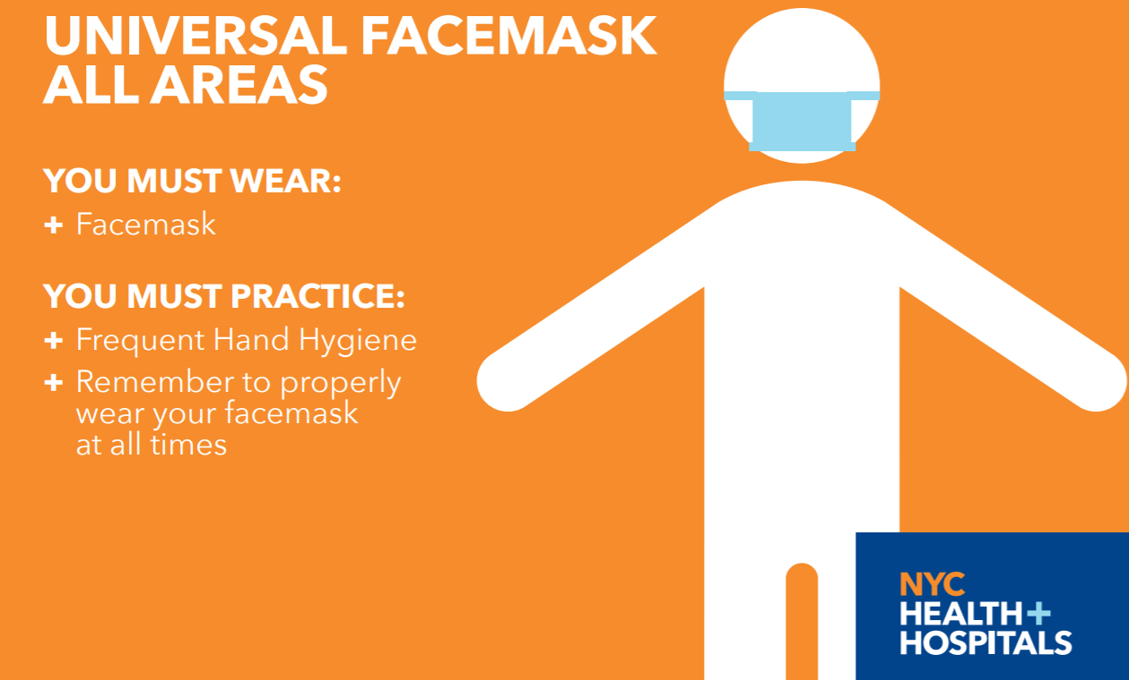
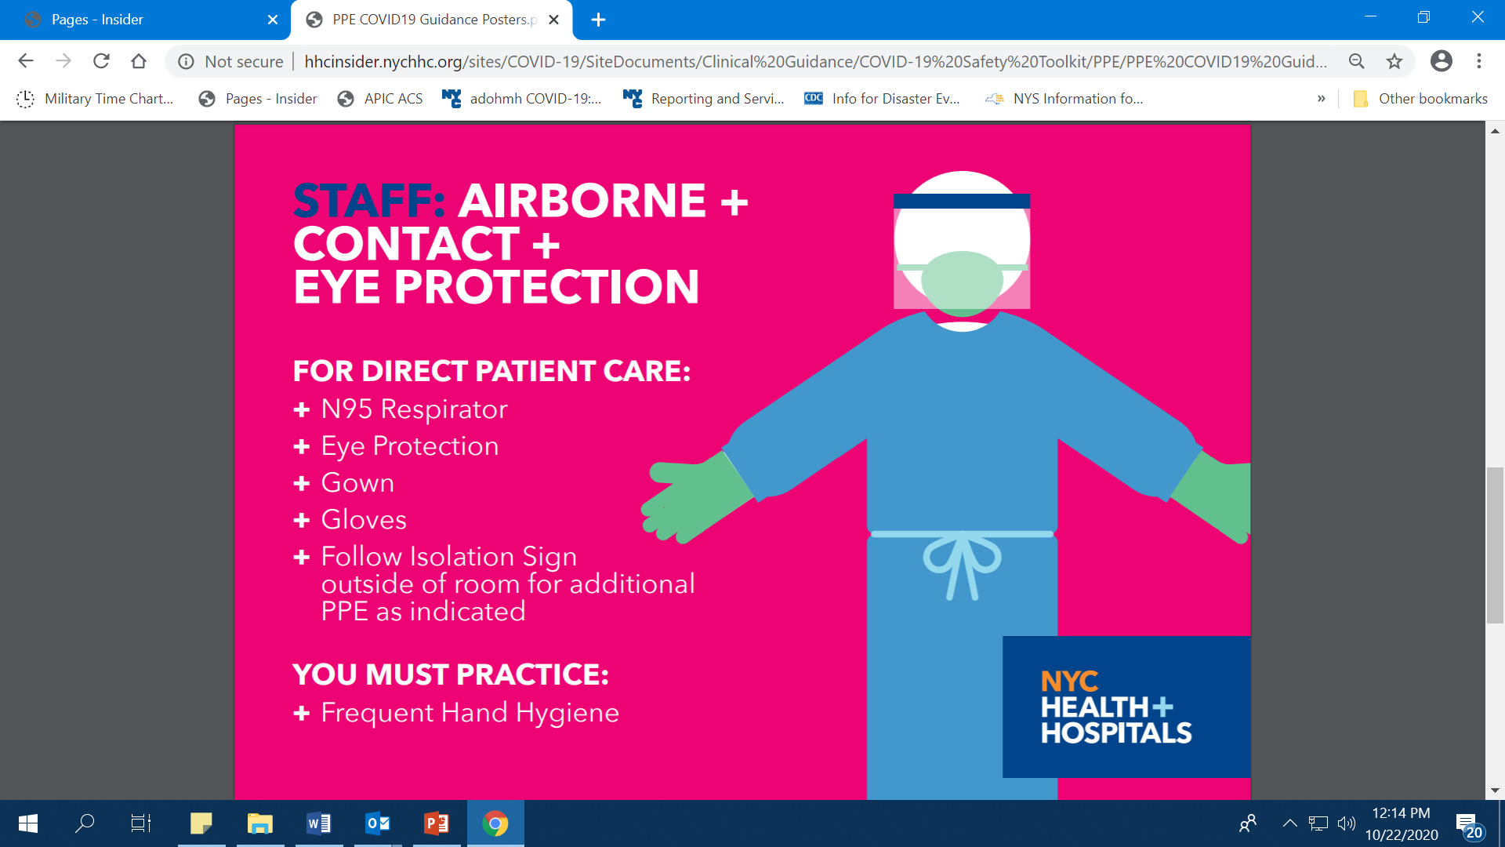
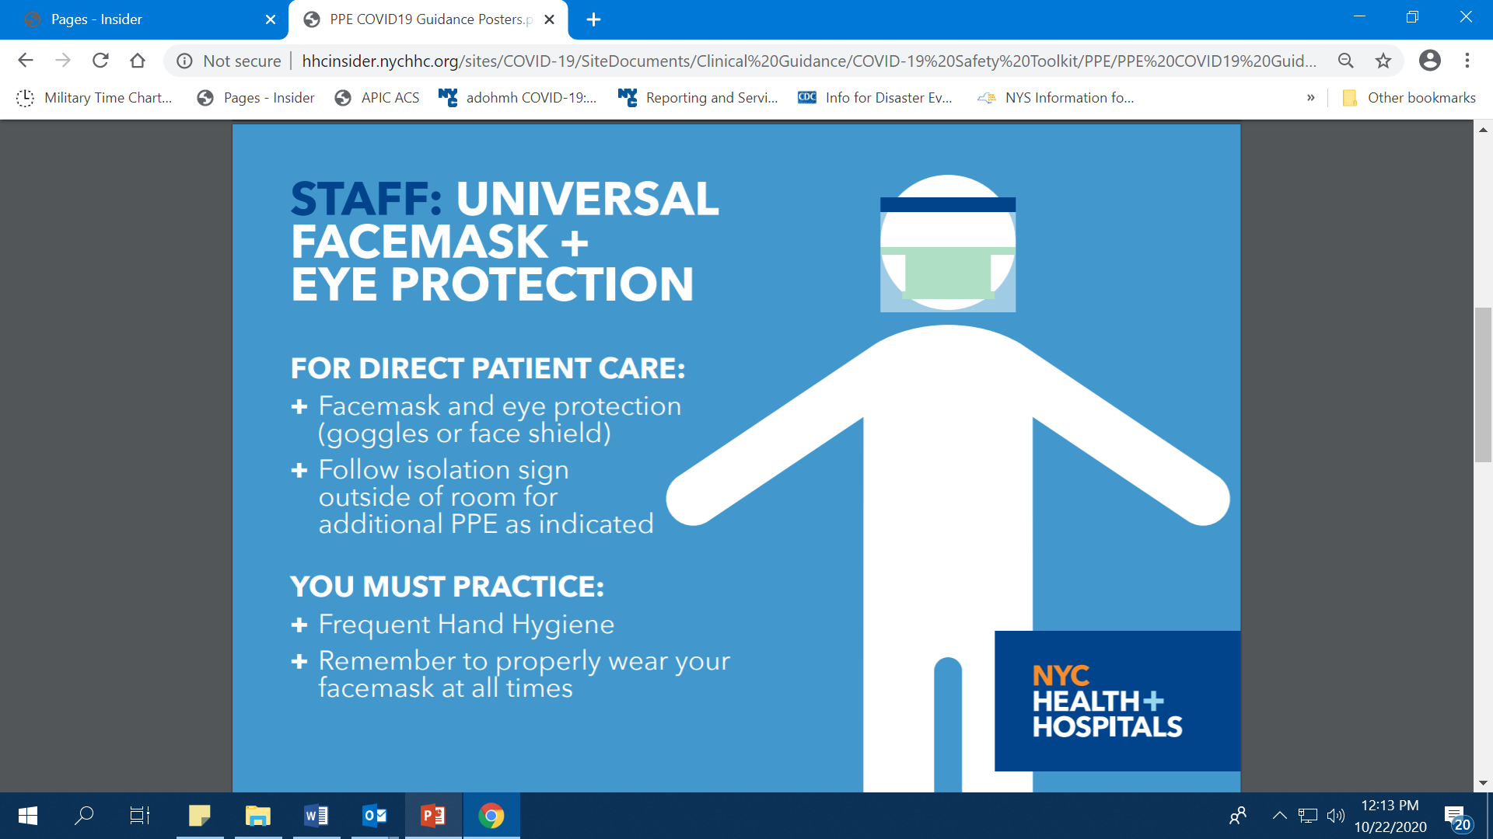
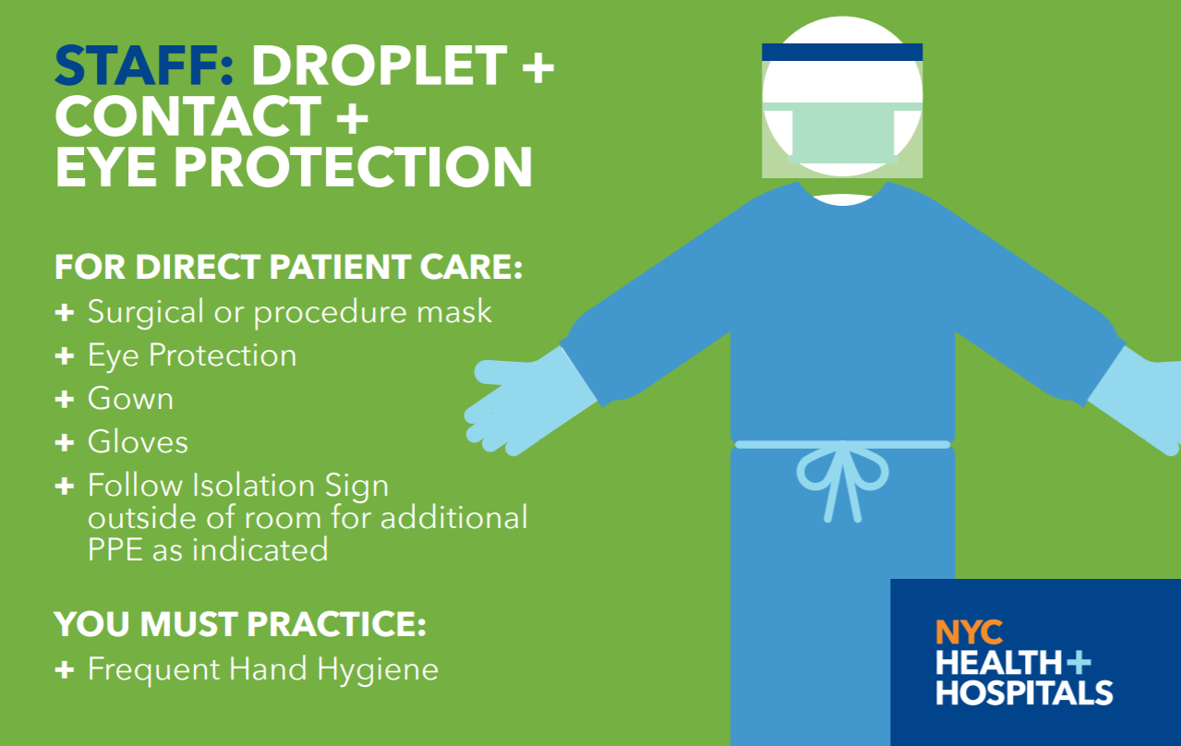
PPE Guidance Posters
Posters are not meant to replace isolation room signage.
These posters serve to guide staff on required PPE when entering dedicated facility specific areas.
All HCP should know where the dedicated COVID-19 units are located in their facility.
Notes:
Posters are not meant to replace isolation room signage. These posters serve to guide staff on required PPE when entering dedicated facility specific areas.
For example, the orange universal masking poster may be placed in all areas of the facility. The green and pink posters may placed at the entrance of a dedicated COVID-19 units.

Slide 18
Click here to view
Donning & Doffing Procedure: Droplet + Contact + Eye Protection

Slide 19
Click here to view:
Donning & Doffing Procedure: Airborne + Contact + Eye Protection

Slide 20
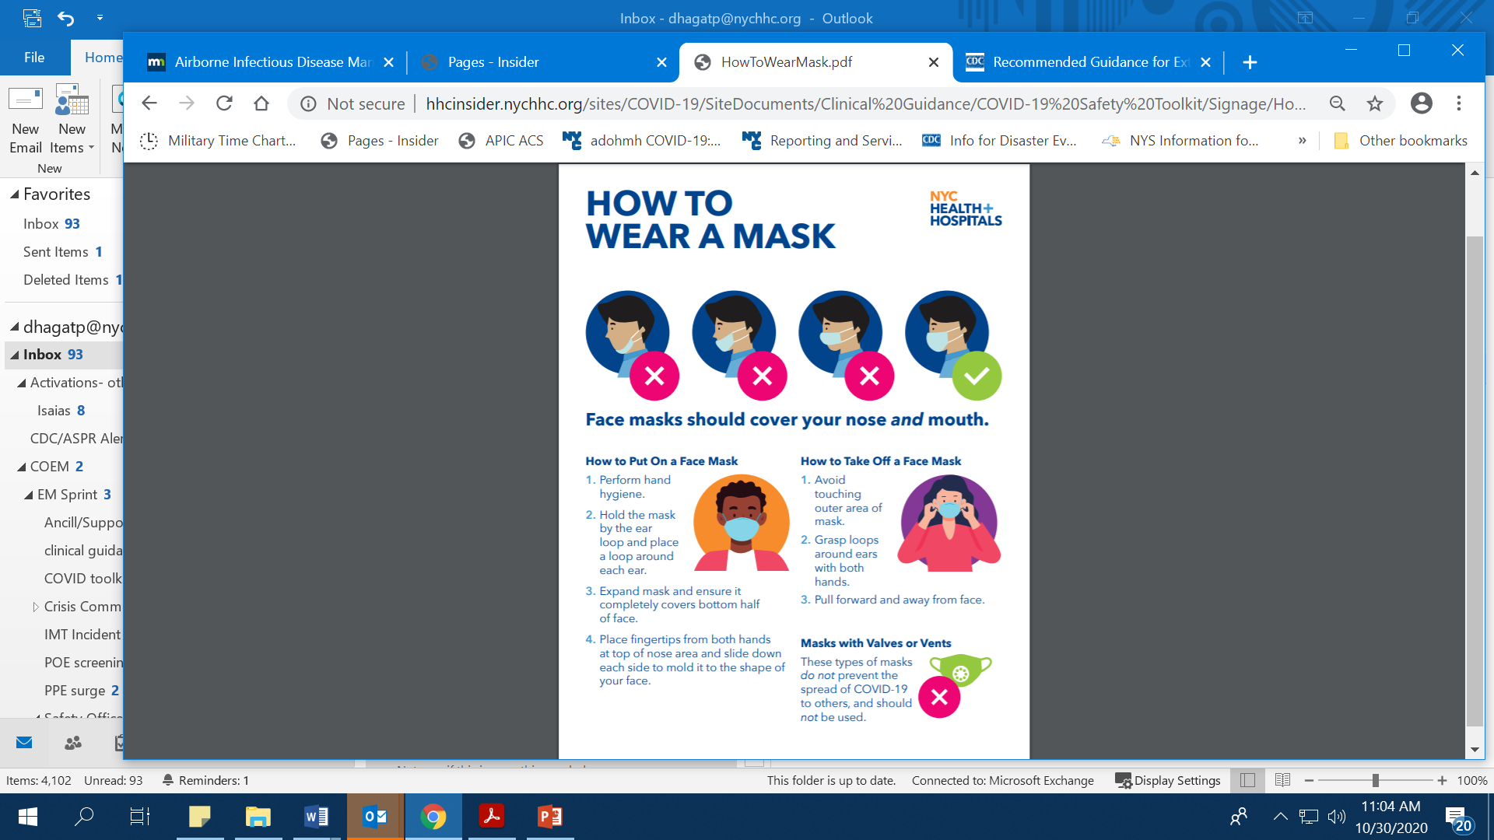
Facemask Tips
Wear surgical or procedure facemasks provided by your facility.
Do not wear masks with valves or vents.

Slide 21
Extended Use vs. Reuse
Extended use refers to wearing the same PPE between patients without removal.
Reuse refers to wearing the same PPE but removing it between patients and may involve a cleaning and disinfection step.
Glove use should not be extended or reused. Gloves should be removed after each patient, followed by hand hygiene.
Notes:
Extended use and reuse may include the masks, protective eye wear and gowns, and is based on H+H guidance when during contingency and crisis capacities or within specific areas or units.

Slide 22
Extended Use of N95 Respirator
If wearing an N95 respirator and a full face shield, the N95 respirator may be worn repeatedly from patient to patient as long as it is not contaminated, wet or damaged.
If wearing an N95 respirator alone, place a surgical or procedure mask on top so as to extend the use the N95 repeatedly from patient to patient. Perform seal check after donning mask to ensure seal is intact.
The use of the same N95 respirator may be extended unless it becomes damaged, contaminated with patient blood and/or body fluids (includes nasal or respiratory secretions) or difficult to breathe through.

Slide 23
N95 Reuse: Definition of 5 Uses
Reuse - refers to the practice of using the same N95 respirator for multiple encounters with patients.
Under no circumstances should an N95 respirator be utilized beyond 5 uses.
5 uses is defined as 5 donnings, regardless of the number of hours the respirator is worn.
Notes:
Place your N95 respirator in a paper bag with your name on it and the date of use. After 5 uses, or if the N95 respirator becomes soiled or damaged, discard into the regular trash.
Source: https://www.cdc.gov/coronavirus/2019-ncov/hcp/respirators-strategy/index.html (see section on limited reuse)

Slide 24
Extended Use and Reuse Reminders for Procedure Masks, N95 Respirators and Eye Protection
DO NOT EXTEND USE OR REUSE IF: Damaged (rips or tears) Contaminated with patient blood and/or body fluids Physical integrity is not intact (e.g., straps no longer functional) Cannot achieve adequate fit Cannot achieve seal check for N95 | ALWAYS REMEMBER TO: Carefully remove the mask/N95 and eye protection using the ear loops or straps to prevent self-contaminating Perform hand hygiene after discarding PPE Inspect reused PPE before each use to ensure its physical integrity is intact; discard if damaged Perform a seal-check to ensure an adequate fit for N95 respirator Perform hand hygiene after putting on reused PPE and before touching patient.

Slide 25
Storage of Eye Protection
Use a disinfectant wipe or soap and water to clean the protective eyewear both inside and outside.
Use a new disinfectant wipe to disinfect the protective eyewear.
After appropriate contact time with the disinfectant, allow protective eyewear to air dry.
Place in a paper bag or breathable container.

Slide 26
Environmental Cleaning and Disinfection
Two step process:
  Cleaning physically removes germs, dirt, and impurities from surfaces or objects by using soap (or detergent) and water. Cleaning does not necessarily kill germs, but by removing them, it lowers their numbers and the risk of spreading infection.
  Disinfecting kills germs on surfaces or objects. Disinfecting works by using chemicals to kill germs on surfaces or objects, which can further lower the risk of spreading infection.
Ensure you use products provided by your facility and follow manufacturers instructions for use and the appropriate contact time.

Slide 27
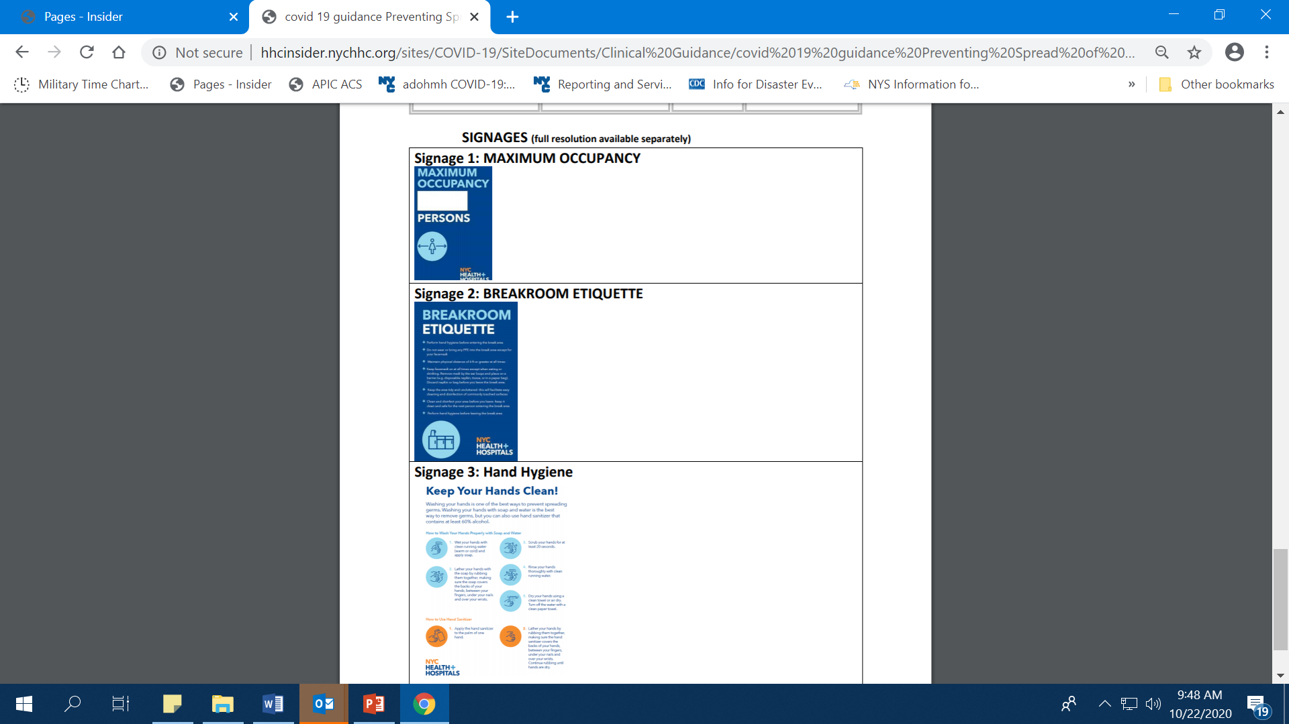
Preventing the Spread of COVID-19 in Breakrooms
Assess the room
  Physical spacing of furnishings;
  availability of trash bins; signage
Ensure supplies are available
  Hand sanitizer stations; availability
  of paper towels and disinfectant wipes
Maintain a clean and uncluttered area
  Facilitates easy cleaning and disinfection
  Prohibit PPE, other than facemask,
  from entering breakroom
Notes:
Break areas are at risk for cross contamination and potential exposure due to limited mask use and potential crowding. When taking a break, ensure you are physically distanced from others, maintain a clean and uncluttered area, disinfect your area prior to leaving, and don’t bring any PPE into the break area, other than your mask. To prevent cross contamination, use a paper bag or napkin to rest your mask in while eating or drinking, and dispose it in a trash bin prior to leaving.

Slide 28
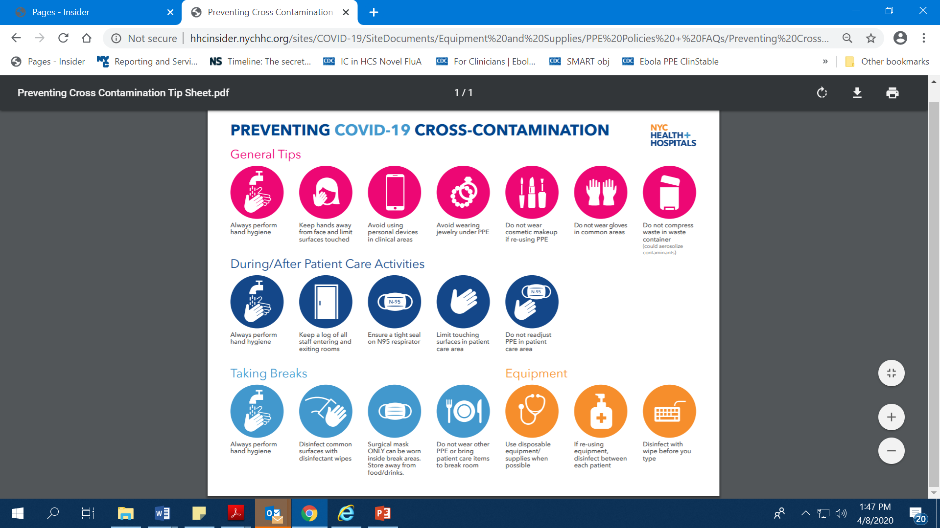
Preventing Cross Contamination
Notes:
In summary, please remember to always perform hand hygiene, keep your hands away from your face, avoid using personal devices in clinical areas, avoid wearing jewelry under PPE, do NOT wear cosmetic makeup if re-using PPE, do not wear gloves in common areas.
.

Slide 29
Questions?
[insert IP contact information]

