Slide 1
Monkeypox Webinar July 27, 2022
Speakers:
Dr. Gabe Cohen, CMIO, Population Health, Infectious Disease Informatics Liaison, EITS Attending, Division of Infectious Diseases, Bellevue Hospital
Kenra Ford, Vice President, Clinical Services Operations, NYC Health + Hospitals
Dr. Syra Madad, Senior Director, System-wide Special Pathogens Program, NYC Health + Hospitals
Dr. Andrew Wallach, Ambulatory Care Chief Medical Officer & Senior Advisor, Division of Medical and Professional Affairs, NYC Health + Hospitals
Dr. Reba Williams, Medical Director, OHS, NYC Health + Hospitals

Slide 2
Monkeypox: Latest Case Counts, Epi information
Syra Madad, DHSc, MSc, MCP
Senior Director
System-wide Special Pathogens Program
NYC Health + Hospitals

Slide 3
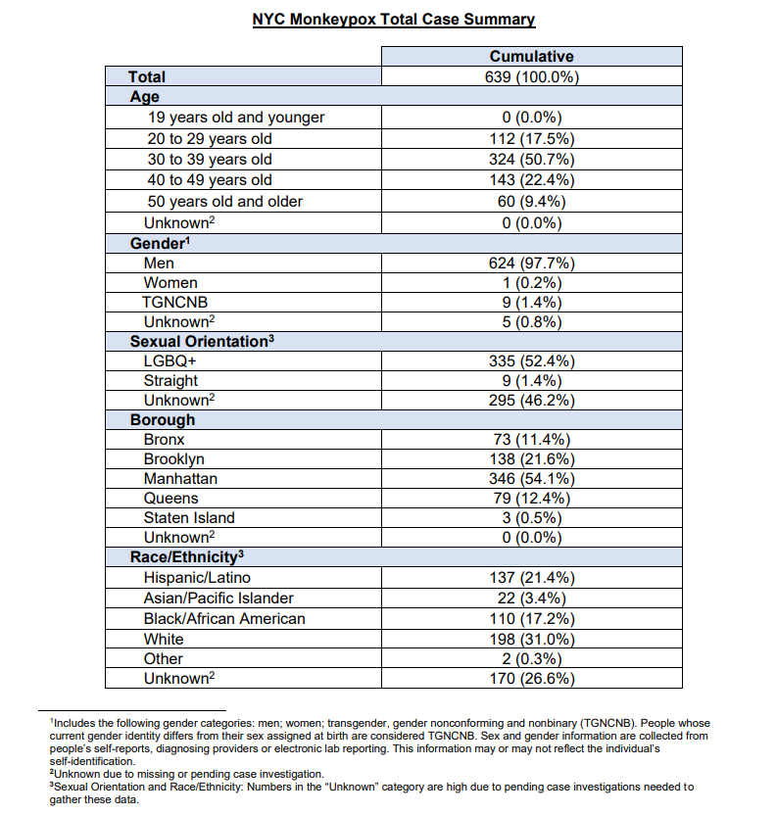
As of July 26:
1,092 NYC
3,591 nationwide
19,188 worldwide
Notes:
The current cases are primarily spreading among social networks of gay, bisexual and other men who have sex with men (MSM).

Slide 4
Retrieved from CDC

Slide 5
Retrieved from CDC

Slide 6
Retrieved from CDC

Slide 7
Monkeypox Vaccine, Testing
Andrew B. Wallach, MD, FACP
Ambulatory Care Chief Medical Officer
Senior Advisor, Division of Medical and Professional Affairs
NYC Health + Hospitals

Slide 8
Monkeypox Testing
Any provider can perform!
Bellevue, Elmhurst and Kings have dedicated programs
No longer need NYC DOHMH approval to test
NYC Health + Hospitals is using an outside reference lab, LabCorp
Epic order: MONKEYPOX, DNA, PCR (SEND OUT) [LABC2102]
Qualitative test
TAT 2-3 days once specimen arrives at LabCorp
> 300 tests sent to-date

Slide 9
Monkeypox Testing
Sample collection
Vigorously swab or brush the base of the lesion with a sterile dry polyester, rayon or Dacron swab
Collect a second swab from the same lesion
Insert both swabs into the sterile plastic aliquot tube or sleeve and break off the end of the swabs, if required, to tightly close the sample
Can sample multiple lesions

Slide 10
Monkeypox Testing
Rules of engagement
Proper PPE required during sample collection
Lab must be notified in-advance that a monkeypox test is being brought over (do not use your routine transport)
Examination room requires ‘terminal clean’ before re-use
Waste should be disposed as ‘regulated medical waste’
unless there is an epidemiological link to the Congo Basin
(then, waste is treated as Category A Waste)

Slide 11
Monkeypox Vaccine
JYNNEOS
Two dose series given 28 days apart
Manufactured by Bavarian Nordic in Denmark
Non-replicating vaccinia virus
FDA-approved for prevention of both smallpox and monkeypox
Limited stockpile in US
May be given before, after or at the same time as other vaccines
mRNA vaccination in young males should be delayed by 4 weeks, if possible

Slide 12
Monkeypox Vaccine
Vaccine Indications/Uses
Post-exposure prophylaxis (PEP)
Expanded post-exposure prophylaxis (PEP++)
Pre-exposure prophylaxis (PrEP)

Slide 13
Monkeypox Vaccine
Post-exposure prophylaxis (PEP)
High-risk contacts to known cases of monkeypox
Determined by the DOHMH contract tracing
Currently being administered at NYC Health + Hospitals/Metropolitan (2 dose series)

Slide 14
Monkeypox Vaccine
Expanded post-exposure prophylaxis (PEP++)
Individuals at high-risk
Gay, bisexual, or other man who has sex with men, and/or transgender, gender non-conforming, or gender non-binary
Age 18 or older
Have had multiple or anonymous sex partners in the last 14 days

Slide 15
Monkeypox Vaccine
Expanded post-exposure prophylaxis (PEP++)
Currently being administered at:
DOHMH Sexual Health Clinics (Chelsea, East Harlem, Corona)
NYC Health + Hospitals/Gotham- Vanderbilt
NYC Health + Hospitals/Lincoln
Currently, single dose

Slide 16
Monkeypox Vaccine
Pre-exposure prophylaxis (PrEP)
Laboratory personnel

Slide 17
Monkeypox Testing
Kenra Ford, FABC, MBA, MT (ASCP)
Vice President
Clinical Services Operations
Laboratory Services
Outbreak Response Testing

Slide 18
Laboratory MPX Submission Process (LabCorp)
EPIC Orderable | MONKEYPOX, DNA, PCR (SEND OUT) [LABC2102]
Test Method | Polymerase chain reaction (PCR)
Collection Instructions | Vigorously swab or brush the base of the lesion with a sterile dry polyester, rayon or Dacron swab. Collect a second swab from the same lesion. Insert both swabs into one sterile tube and break off the end of the swabs, if required, to tightly close the sample. Do not add any transport media to the sample. Two swabs should be submitted to ensure adequate material is sampled. If lesions with differing appearances are present, submit an additional set of swabs on a separate order.
Sample Routing | Samples for testing will route through our Northwell/HHC CLNY lab on to LabCorp based on current workflows in place for each site, including Gotham.
Turn-Around- Time | 2-3 days upon receipt of samples to LabCorp
Electronic Integration | Seamless electronic integration allows MPX results to post in EPIC as other test results
Performance Monitoring | Performed by System Lab Services daily
Specimen Stability | Refrigerated 7 Days Frozen 30 Days

Slide 19
Informatics update
Gabriel M Cohen, MD
CMIO, Population Health
Infectious Disease Informatics Liaison, EITS
Attending, Division of Infectious Diseases, Bellevue Hospital

Slide 20
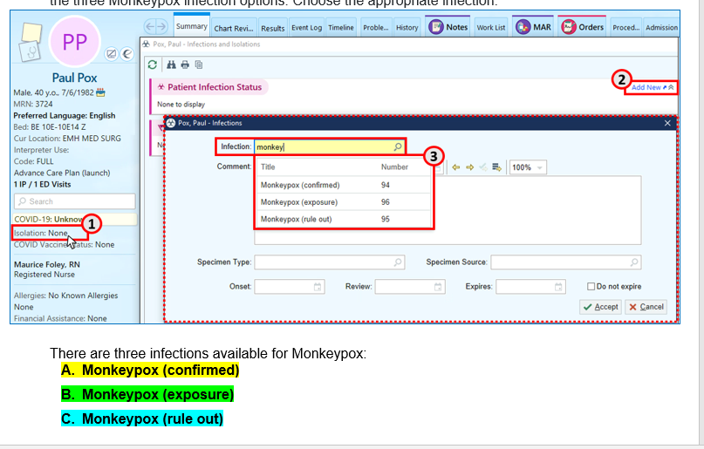
Infection Status

Slide 21
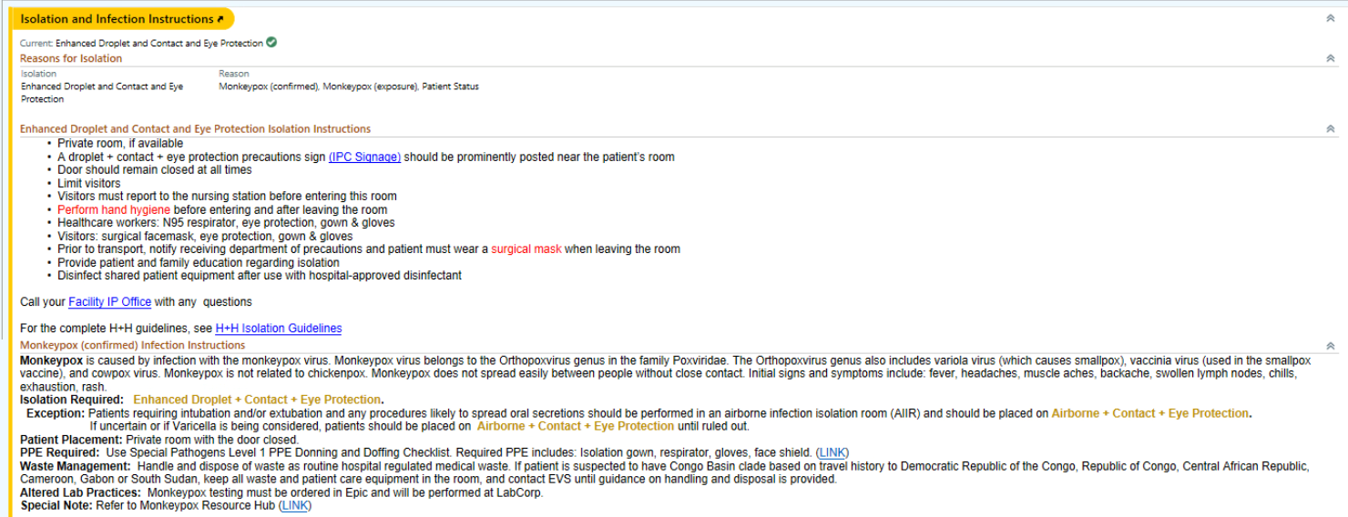
Isolation/Infection Instructions

Slide 22
Monkeypox lab ordering triggers a “rule out” infection status

Slide 23
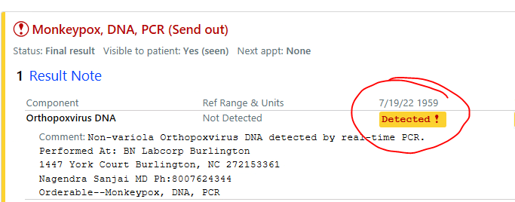
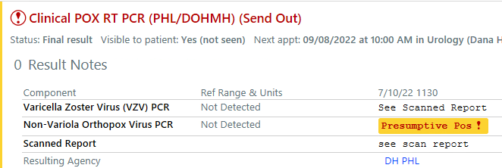
Positive results trigger a “confirmed” status

Slide 24
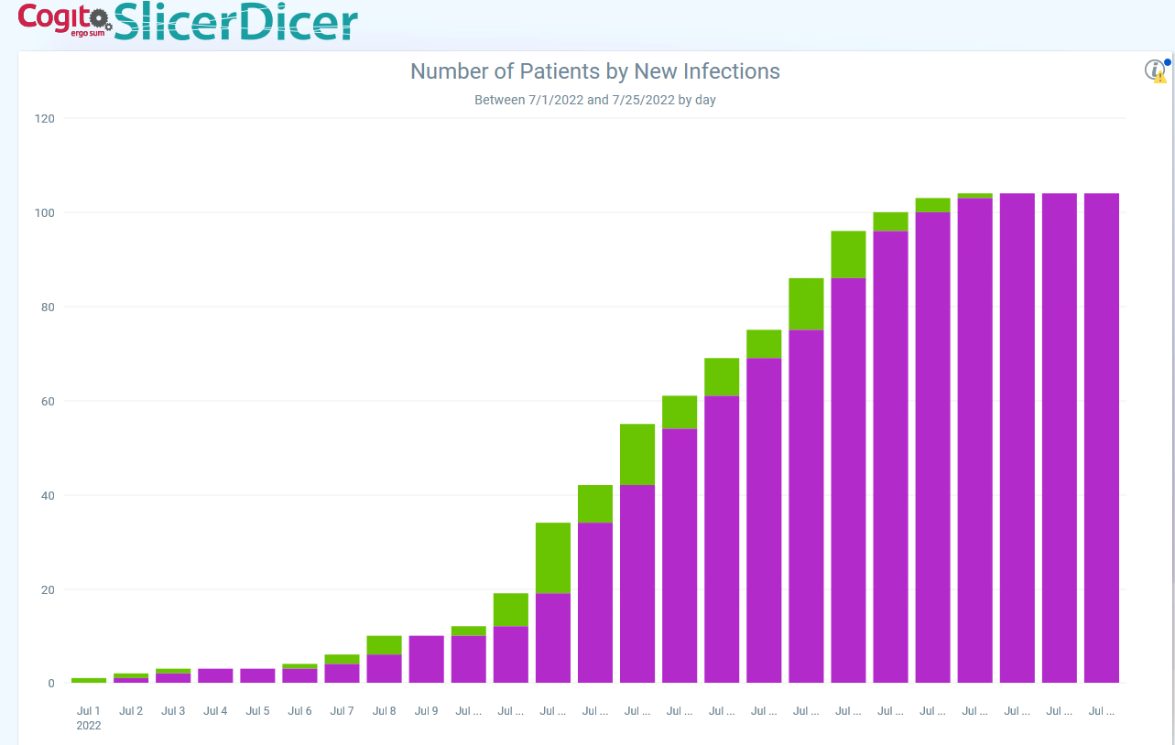
Recent data

Slide 25
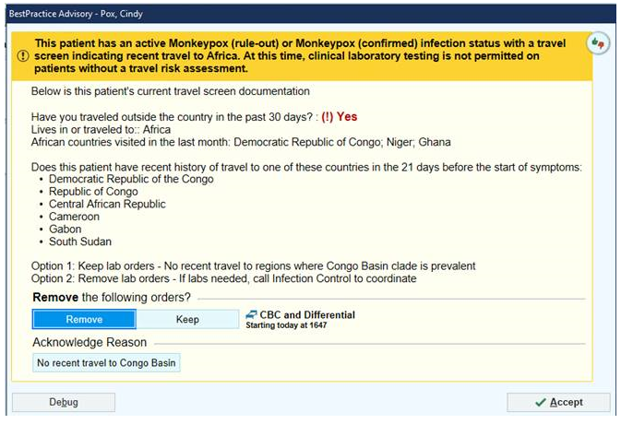
BPA for Congo Basin clade

Slide 26
OHS Update
Reba Williams, MD
Medical Director, OHS, NYC Health + Hospitals

Slide 27
Monkeypox monitoring and reporting
All NYC H+H Personnel (HCP) notify OHS of suspected, potential or confirmed exposure to Monkeypox/Orthopoxvirus with or without symptoms
OHS completes an Exposure Risk Assessment. Transmission of Monkeypox requires prolonged close contact with a symptomatic individual. Brief interactions and those conducted using appropriate PPE in accordance with Standard Precautions are not high risk
OHS will classify the HCP into the appropriate exposure risk category

Slide 28
Monkeypox monitoring and reporting
Monitoring exposed personnel (occupational or non-occupational exposure)
HCP should monitor for development of symptoms suggestive of Monkeypox infection, especially within the 21-day period after the last date of care or exposure using the OHS Exposure Monitoring Tool
HCPs who have unprotected exposures (i.e., not wearing PPE) to patients with Monkeypox or exposure to any other person with Monkeypox have no work restrictions, but should undergo active monitoring, including measurement of temperature and symptom reporting at least twice daily for 21 days following the exposure using the OHS Exposure Monitoring Tool/App
Prior to reporting for work each day, the HCP being monitored must report evidence of symptoms especially fever or rash
HCP who have cared for or otherwise been in direct or indirect contact with Monkeypox patients while wearing appropriate PPE and practicing Standard Precautions have no work restrictions and will self-monitor as directed by OHS or the Department of Health
OHS educates the HCP on the development of symptoms that could suggest Monkeypox infection, especially within the 21-day period after the last date of care or exposure

Slide 29
OHS Exposure Risk Assessment
Question | Answer
1. Date and time of exposure | Date: Time:
2. All temperatures in Fahrenheit for last 24 hours. Temperatures > 100.4ºF are considered a fever.
3. Do you have any symptoms to report (fever (≥100.4°F), chills, new swollen lymph nodes (periauricular, axillary, cervical, or inguinal lymphadenopathy), and/or new skin rash)? | Yes or No * If yes, record a brief description of symptoms.
4. Does your assigned work involve possible exposure to a confirmed patient or the patient’s belongings or immediate environment (includes lab specimens)? | Yes or No
NOTE: If OHS determines the HCP is exposed, HCP must continue self-monitoring through the Monkeypox app for 21 days but does not require work restriction.

Slide 30
Exposure Risk Assessment for HCP Exposed to Patient with confirmed Monkeypox
Degree of Exposure | Exposure Characteristics | H+H OHS Guidance
Low/Uncertain | • Entered the patient room without wearing eye protection on one or more occasions, regardless of duration of exposure -OR- • During all entries in the patient care area or room (except for during any procedures listed below in the high-risk category), wore gown, gloves, eye protection, and at minimum, a surgical mask -OR- • Being within 6 feet of an unmasked patient for less than 3 hours without wearing at minimum, a surgical mask -OR- • Exposure that, at the discretion of public health authorities, was recategorized to this risk level based on unique circumstances (e.g., uncertainty about whether Monkeypox virus was present on a surface and/or whether a person touched that surface | HCP do not need to be excluded from work duty HCP will be required to complete the Monkeypox monitoring app including measure and record their temperature twice a day and at 12-hour intervals HCP must complete the Monkeypox Monitoring App daily prior to reporting to work OHS will monitor the Monkeypox App for compliance with completion of the daily Monkeypox App reporting If HCP develops new fever or symptoms, they must self-isolate immediately, and contact OHS for further instructions
Note: Transmission of Monkeypox requires prolonged close interaction with a symptomatic individual. Brief interactions and those conducted using appropriate PPE in accordance with Standard Precautions are not high risk and do not warrant postexposure prophylaxis.

Slide 31
Exposure Risk Assessment for HCP Exposed to Patient with confirmed Monkeypox
Degree of Exposure | Exposure Characteristics | H+H OHS Guidance
Intermediate | Being within 6 feet for 3 hours or more of an unmasked patient without wearing, at a minimum, a surgical mask -OR- Activities resulting in contact between sleeves and other parts of an individual’s clothing and the patient’s skin lesions or bodily fluids, or their soiled linens or dressings (e.g., turning, bathing, or assisting with transfer) while wearing gloves but not wearing a gown –OR Lab HCP within 6 feet of an analytic instrument (not contained within a biosafety cabinet (BSC) and/or not wearing appropriate PPE to prevent aerosol or another direct exposure) while specimens from a confirmed MPX case-patient were loaded, run, and/or unloaded, or one hour after unloading the specimens Exposure that, at the discretion of public health authorities, was recategorized to this risk level because of unique circumstances (e.g., if the potential for an aerosol exposure is uncertain, public health authorities may choose to decrease risk level from high to intermediate) | HCP do not need to be excluded from work duty Any intermediate risk exposures to be referred directly to OHS who will review plan for monitoring and possible post-exposure prophylaxis with Monkeypox vaccine, Jynneos HCP must complete the Monkeypox Monitoring App, including their temperature twice a day The HCP must complete the Monkeypox Monitoring App daily prior to reporting to work If HCP develops new fever or symptoms, they must self-isolate immediately, and contact OHS for further instructions

Slide 32
Exposure Risk Assessment for HCP Exposed to Patient with confirmed Monkeypox
Degree of Exposure | Exposure Characteristics | H+H OHS Guidance
High | Unprotected contact between a person’s skin or mucous membranes and the skin, lesions, or bodily fluids from a patient (e.g., any sexual contact, inadvertent splashes of patient saliva to the eyes or oral cavity of a person, ungloved contact with patient), or contaminated materials (e.g., linens, clothing) -OR- Being inside the patient’s room or within 6 feet of a patient during any procedures that may create aerosols from oral secretions, skin lesions, or resuspension of dried exudates (e.g., shaking of soiled linens), without wearing an N95 or equivalent respirator (or higher) and eye protection -OR- Exposure that, at the discretion of public health authorities, was recategorized to this risk level (i.e., exposure that ordinarily would be considered a lower risk exposure, raised to this risk level because of unique circumstances) | Any high-risk exposures should be immediately quarantine and call OHS for further instructions OHS will coordinate with hospital leadership, IPaC and NYSDOH a plan of care for the HCP that will include possible post-exposure prophylaxis with Monkeypox vaccine, Jynneos
Escalation for Non-Response from HCP:
If HCP does not respond to a phone call or electronic notification to complete survey, attempts should be made to reach the HCP and emergency contact including repeat phone calls every 2 hours until HCP responds.
If HCP is not reachable after 3 electronic notifications or interval phone calls (i.e. first call plus two additional calls), notification will be sent to hospital leadership (e.g., CEO and CMO).

Slide 33
Monkeypox Return to Work Criteria
HCP who develop any of the symptoms within 21 days of exposure, do-not report to work, self-isolate immediately and contact OHS for isolation instructions
HCP who is either confirmed with Monkeypox or Orthopoxvirus infection do-not report to work, self-isolate immediately and contact OHS for isolation instructions
Return to work Criteria:
At least 2 weeks has passed since date of onset of first Monkeypox skin lesion
Afebrile for at least 72 hours without fever-reducing medication
No new skin or mucosal lesions in the previous 72 hours
All lesions have scabbed over, all the scabs have fallen off and a fresh layer of skin has formed underneath
No lesions in mouth
All HCPs must adhere to Standard Precautions and wear a N95 respirator or equivalent, protective eye wear, and gloves when patient facing and/or providing patient care. Cloth masks are prohibited

Slide 34
Monkeypox Clinical Guidance’s and Resource Hub
Syra Madad, DHSc, MSc, MCP
Senior Director
System-wide Special Pathogens Program
NYC Health + Hospitals

Slide 35
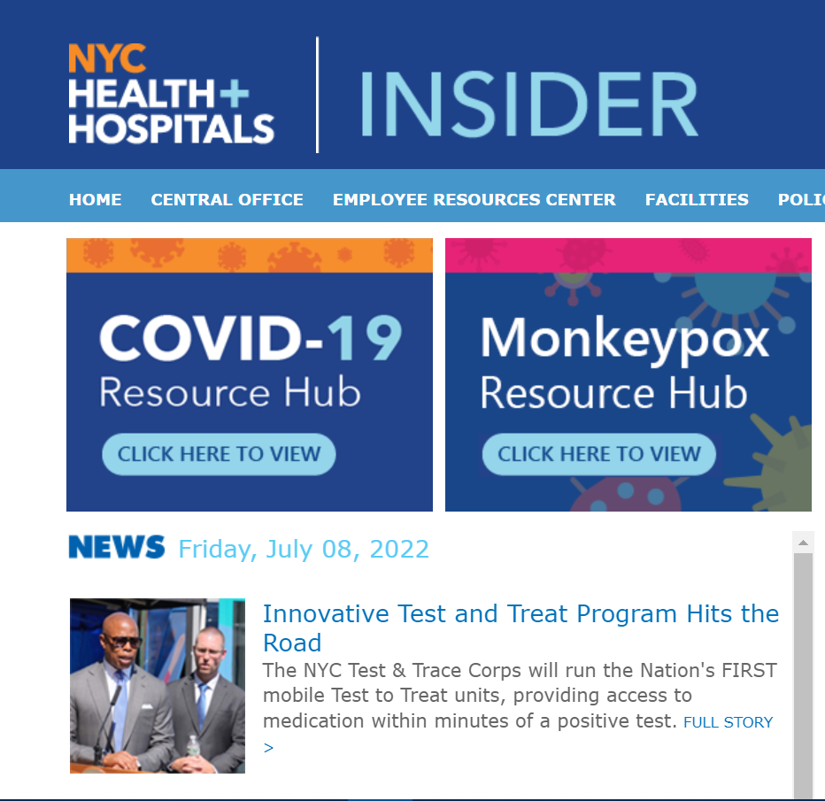

Slide 37
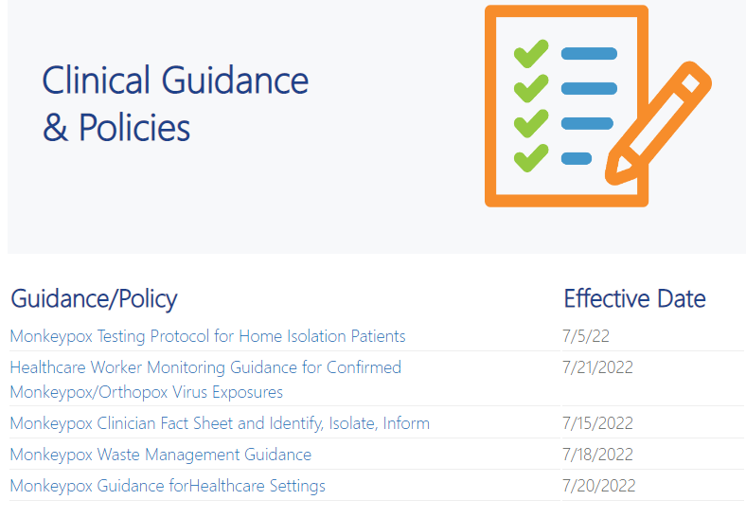

Slide 38
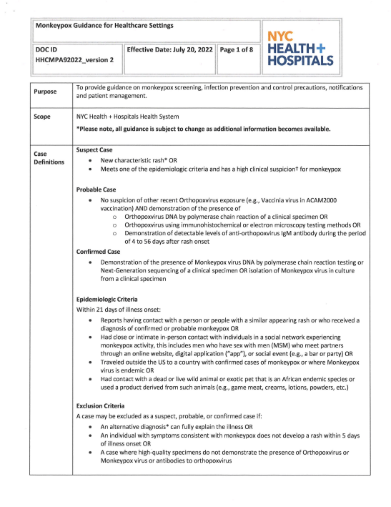
Healthcare Setting Guidance
Clinical recognition, atypical presentation, testing, vaccine and treatment information
PPE, transmission-based precautions, EVS, visitor guidance

Slide 39
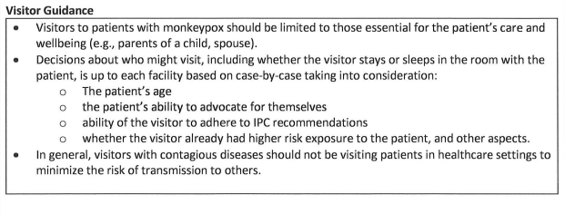

Slide 40
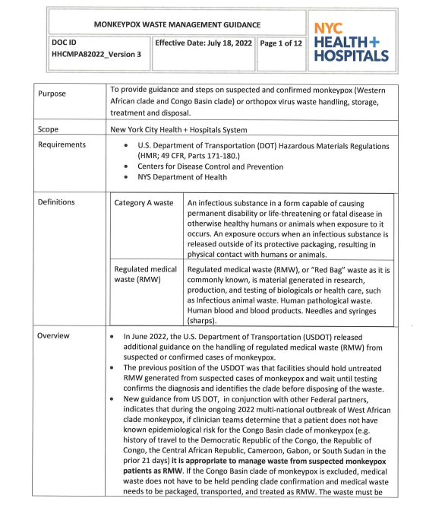
Monkeypox Waste Management
Waste generated during patient care for monkeypox (suspected and confirmed) can be handled as regulated medical waste
If patient has travel history to areas where congo basin clade is circulating, waste generated will be handled as Category A waste until clade identification and EVS must be notified

Slide 41
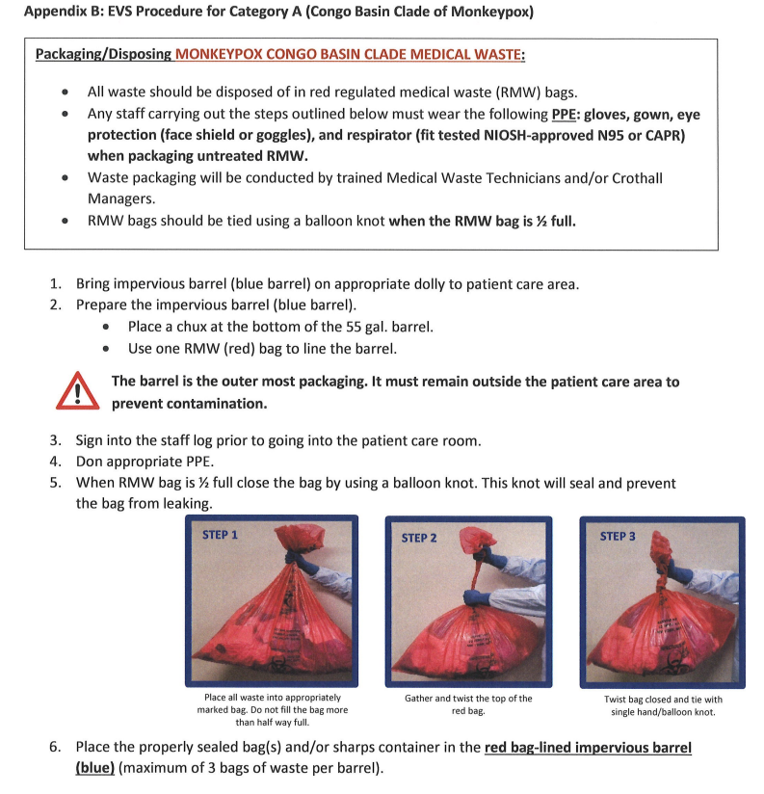

Slide 42
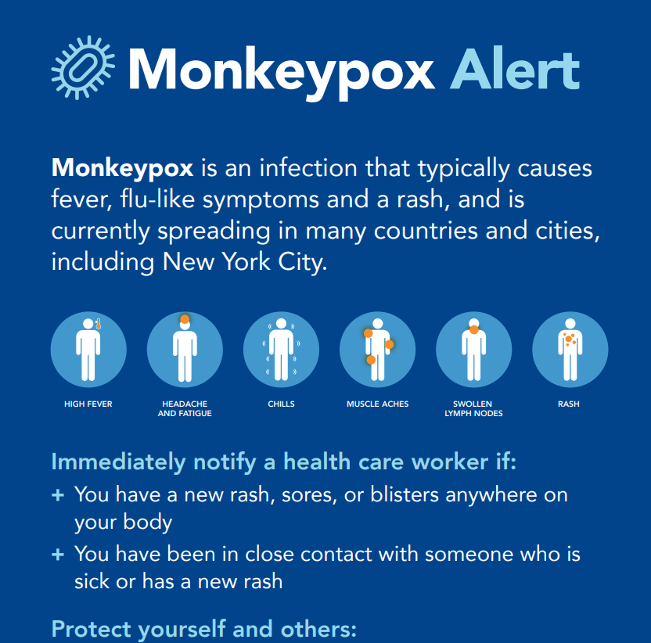
Additional Resources in available
Monkeypox signage for point of entry
Monkeypox Infection and Isolation Order Tip Sheet
FAQ on monkeypox
(Under development: patient discharge instructions)

Slide 43
